Slide 1
GeneSieve: A Knowledge Network Interface for Gene Discovery Across Diverse Crop Species
M.S. Thesis Defense – Pranav Pujar
Advisor: Dr. Chengkai Li
Committee Members: Dr. Gautam Das, Dr. Negin Fraidouni
Notes:
Hello everyone – thank you for being here. My name is Pranav.
Today I’m excited to present my dissertation defense GeneSieve.

Slide 2
Thesis Project Background
  Started in Summer 2022
  USDA-UTA collaborative internship project
  Previous work done: web interface, database creation, preliminary modeling
  My contribution: gene ranking model, trait similarity model, web interface enhancement and maintenance.
Notes:
- joined uta as an undergrad in fall 2021
- joined the IDIR Lab June 2024 as an undergraduate research assistant
- did a few internships @ big tech along the way
- completing fast track masters now

Slide 3

Dr. Justin Vaughn
Scientist in Residence, HudsonAlpha
Prev. @ USDA-ARS
Plant Genomics Expert for GeneSieve
Notes:
I want to conclude by thanking all of you for listening and thanking those who supported this journey. This research spanned several years and wouldn’t have been possible without my advisor, committee, colleagues, and the annotators and participants who contributed. I truly appreciate your time and attention today.

Slide 4
Outline
1. Self-Introduction
5. Gene Ranking Models
2. GeneSieve Overview
6. Trait Similarity Models
3. Biological Evidence Data
7. Website Live Demo
4. Trait-Gene Association Graph
8. Conclusion
Notes:
- In this talk, I’ll walk you through the aim of GeneSieve, the core data model that powers it, and how GeneSieve uses computational methods and machine learning to achieve its aim.
- how the datasets work and how i built the models in it.

Slide 5
Outline
1. Self-Introduction
5. Gene Ranking Models
2. GeneSieve Overview
6. Trait Similarity Models
3. Biological Evidence Data
7. Website Live Demo
4. Trait-Gene Association Graph
8. Conclusion

Slide 6
Self-Introduction
  Pranav Pujar
  B.S. + M.S. in CS @ UT Arlington
  GRA @ IDIR Lab | SWE Intern @ AMD, Adobe
  Outstanding Master's Student Award – 2026
  Lonestar Scholarship, Dean's List x4
Notes:
- joined uta as an undergrad in fall 2021
- joined the IDIR Lab June 2024 as an undergraduate research assistant
- did a few internships @ big tech along the way
- completing fast track masters now

Slide 7
Self-Introduction
  Pranav Pujar
  B.S. + M.S. in CS @ UT Arlington
  GRA @ IDIR Lab | SWE Intern @ AMD, Adobe
  Outstanding Master's Student Award – 2026
  Lonestar Scholarship, Dean's List x4
Notes:
- joined uta as an undergrad in fall 2021
- joined the IDIR Lab June 2024 as an undergraduate research assistant
- did a few internships @ big tech along the way
- completing fast track masters now

Slide 8
Self-Introduction
  Pranav Pujar
  B.S. + M.S. in CS @ UT Arlington
  GRA @ IDIR Lab | SWE Intern @ AMD, Adobe
  Outstanding Master's Student Award – 2026
  Lonestar Scholarship, Dean's List x4
Notes:
- also won a couple of academic honors along the way

Slide 9
Outline
1. Self-Introduction
5. Gene Ranking Models
2. GeneSieve Overview
6. Trait Similarity Models
3. Biological Evidence Data
7. Website Live Demo
4. Trait-Gene Association Graph
8. Conclusion
Notes:
- lets get into what GeneSieve is all about
- what the main aim is

Slide 10
GeneSieve Overview
Genes are largely responsible for trait expression
Plant Scientists want to know – which gene is responsible for a trait?
Experimentally validating genes is costly & slow
Need for computational methods
Notes:
- its a known fact that genes are responsible for trait expression
- env factors can contribute, but for now lets assume the env is perfect
- want to know which genes are responsible for a trait, i.e. have a causal relationship with specific trait
- want to rank genes based on strength of causal relationship to trait
- want this analysis to be applicable cross-species

Slide 11
GeneSieve Overview
GeneSieve prioritizes genes based on evidence for their causal role in a trait
The evidence is represented using a data model called a Trait-Gene Association Graph (TGAG)
TGAG integrates evidence collected from:
  Known trait-gene associations
  Gene-gene co-expression
  Trait-trait semantic similarity
  Gene-gene sequence homology
Notes:
- its a known fact that genes are responsible for trait expression
- env factors can contribute, but for now lets assume the env is perfect
- want to know which genes are responsible for a trait, i.e. have a causal relationship with specific trait
- want to rank genes based on strength of causal relationship to trait
- want this analysis to be applicable cross-species

Slide 12
GeneSieve Overview
GeneSieve uses relational GCN to prioritize genes
GeneSieve provides a web interface to explore biological evidences connecting traits to genes
Website live at http://idir.uta.edu/genesieve
Notes:
- its a known fact that genes are responsible for trait expression
- env factors can contribute, but for now lets assume the env is perfect
- want to know which genes are responsible for a trait, i.e. have a causal relationship with specific trait
- want to rank genes based on strength of causal relationship to trait
- want this analysis to be applicable cross-species

Slide 13
GeneSieve Web Interface
Users can submit queries (natural language trait + candidate gene set)
View ranked candidates and their Trait-Gene Association Graphs (TGAGs)
Browse benchmark TGAGs for queries with candidate gene sets containing an experimentally validated causal gene
Notes:
- its a known fact that genes are responsible for trait expression
- env factors can contribute, but for now lets assume the env is perfect
- want to know which genes are responsible for a trait, i.e. have a causal relationship with specific trait
- want to rank genes based on strength of causal relationship to trait
- want this analysis to be applicable cross-species

Slide 14
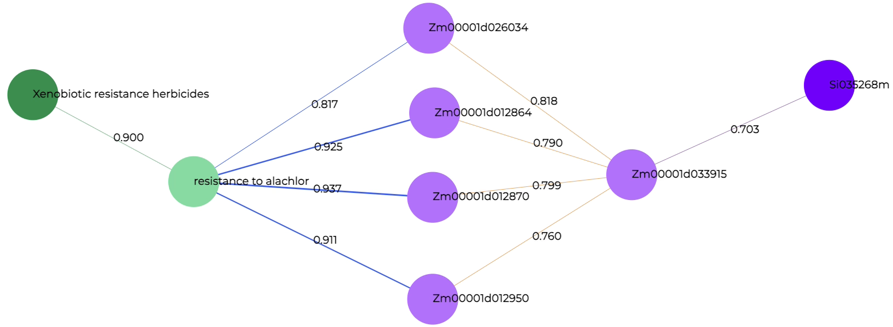
Trait-Gene Association Graph (TGAG)
Input Trait
Traits
Genes
Candidate Gene
Notes:
- example TGAG showing various biological evidence paths connecting a trait to a candidate
- user has provided the trait and candidate, rest are from GeneSieve system

Slide 15
Trait-Gene Association Graph (TGAG)
Input Trait
Traits
Genes
Candidate Gene
Trait Similarity
Notes:
- example TGAG showing various biological evidence paths connecting a trait to a candidate
- user has provided the trait and candidate, rest are from GeneSieve system

Slide 16
Trait-Gene Association Graph (TGAG)
Input Trait
Traits
Genes
Candidate Gene
Trait-Gene Association
Notes:
- example TGAG showing various biological evidence paths connecting a trait to a candidate
- user has provided the trait and candidate, rest are from GeneSieve system

Slide 17
Trait-Gene Association Graph (TGAG)
Input Trait
Traits
Genes
Candidate Gene
Gene Co-expression
Notes:
- example TGAG showing various biological evidence paths connecting a trait to a candidate
- user has provided the trait and candidate, rest are from GeneSieve system

Slide 18
Trait-Gene Association Graph (TGAG)
Input Trait
Traits
Genes
Candidate Gene
Gene Homology
Notes:
- example TGAG showing various biological evidence paths connecting a trait to a candidate
- user has provided the trait and candidate, rest are from GeneSieve system

Slide 19
Novelty and Contributions
Integrates complementary biological evidence in a unified framework, unlike prior methods that rely on a single evidence source.
Introduces dynamically constructed query-specific TGAGs. Existing graph-based approaches use static biological networks.
Notes:
- its a known fact that genes are responsible for trait expression
- env factors can contribute, but for now lets assume the env is perfect
- want to know which genes are responsible for a trait, i.e. have a causal relationship with specific trait
- want to rank genes based on strength of causal relationship to trait
- want this analysis to be applicable cross-species

Slide 20
Novelty and Contributions
Features an R-GCN-based ranking framework for heterogeneous TGAGs. This enables learning across diverse biological relationships while preserving query specificity.
Extends candidate gene ranking to cross-species plant gene prioritization. Existing methods provide limited cross-species support.
Notes:
- its a known fact that genes are responsible for trait expression
- env factors can contribute, but for now lets assume the env is perfect
- want to know which genes are responsible for a trait, i.e. have a causal relationship with specific trait
- want to rank genes based on strength of causal relationship to trait
- want this analysis to be applicable cross-species

Slide 21
Outline
1. Self-Introduction
5. Gene Ranking Models
2. GeneSieve Overview
6. Trait Similarity Models
3. Biological Evidence Data
7. Website Live Demo
4. Trait-Gene Association Graph
8. Conclusion
Notes:
- lets dive into datasets we obtained from the USDA-ARS (agro research service)

Slide 22
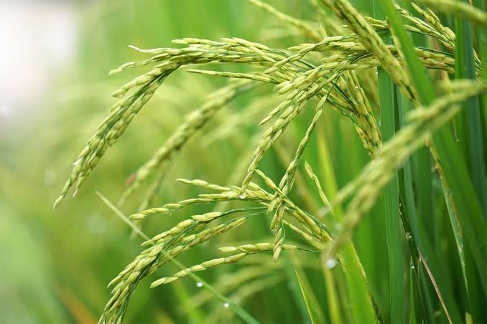
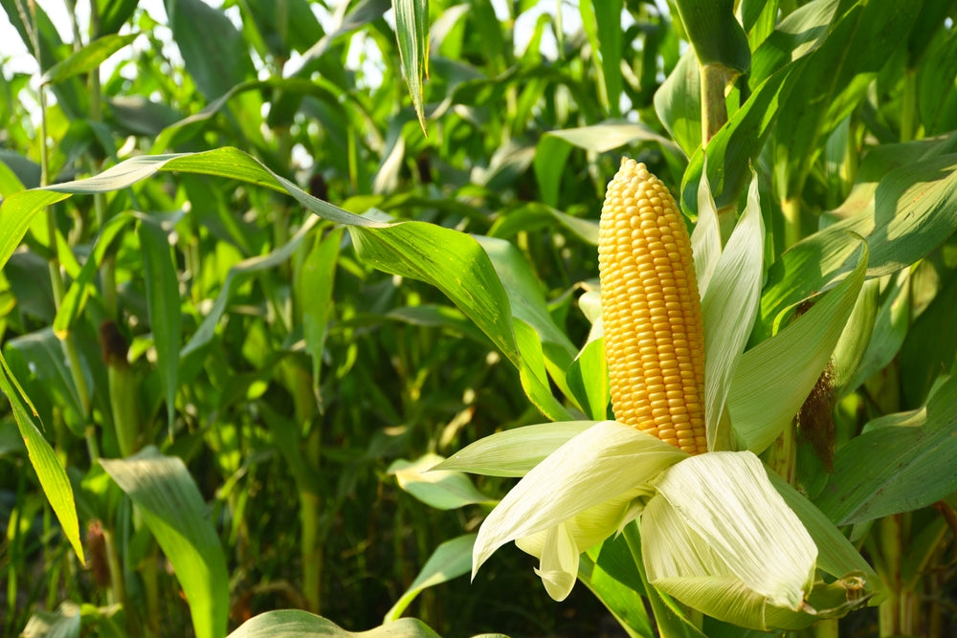
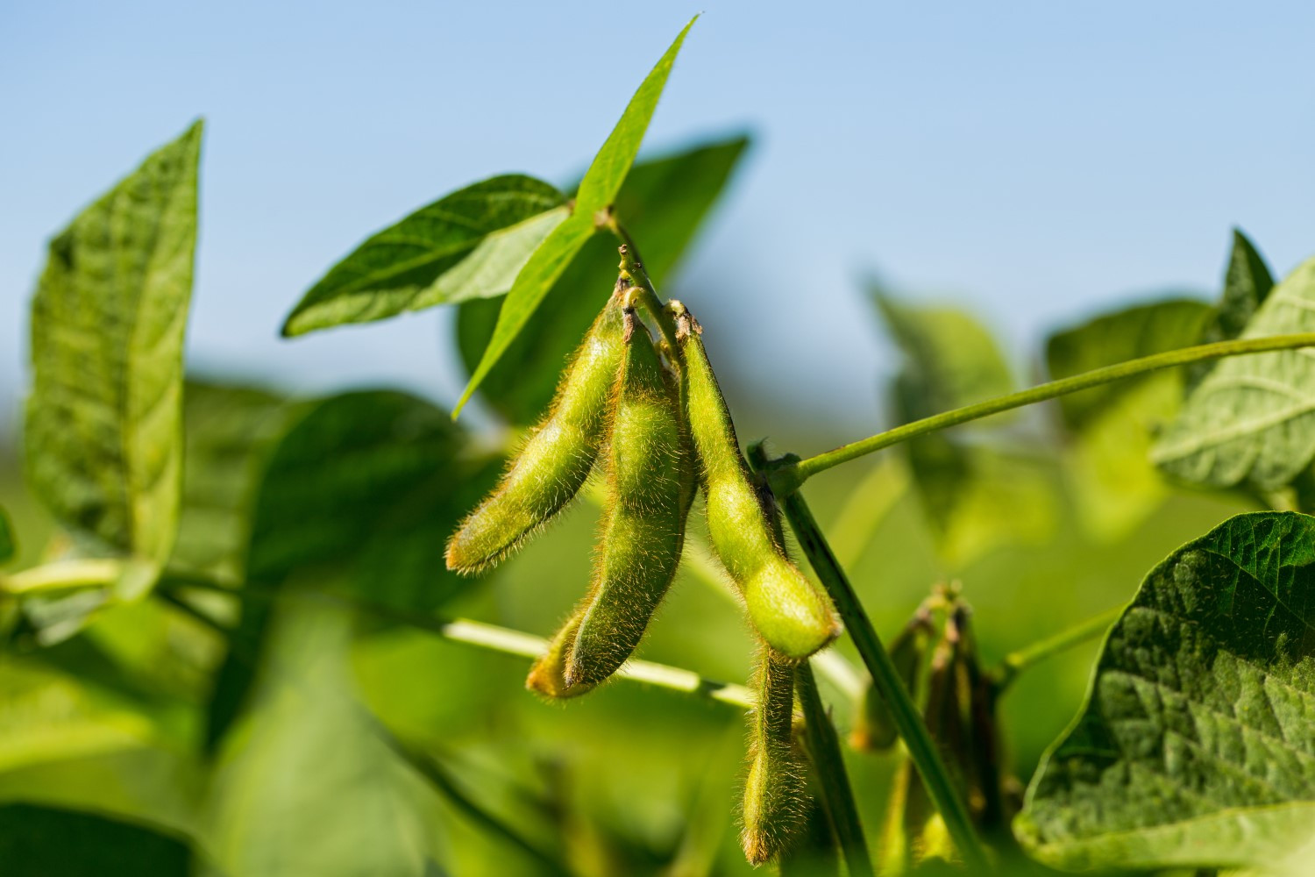
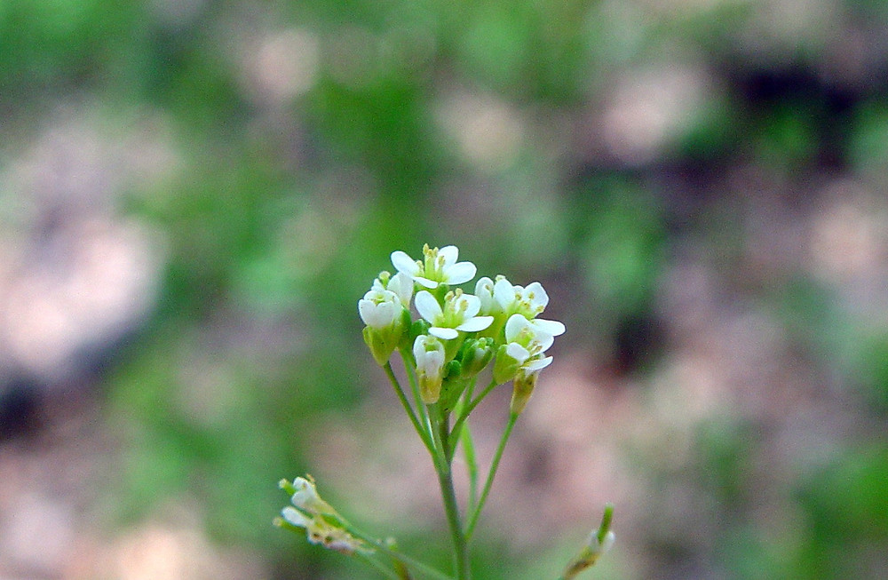
Biological Evidence Data
GeneSieve sources data for 4 plant species
Rice
Maize
Soy
Arabidopsis
Notes:
- Genes from rice, maize, soybean, and Arabidopsis were chosen because they capture broad evolutionary and genomic diversity across flowering plants
- provides the ability to generalize to many other plant species

Slide 23
Biological Evidence Data
Trait-Gene Association Database
Gene-Gene Co-expression Database

Slide 24
Biological Evidence Data
Trait-Gene Association (QTL) Database
Quantitative Trait Locus - a specific region in DNA responsible for a trait.
GeneSieve contains 952,630 distinct QTL associations, linking 1,055 traits to 127,611 genes.
Gene-Gene (Co-expression) Database
Notes:
- almost a million distinct trait-gene associations across 4 plant species

Slide 25
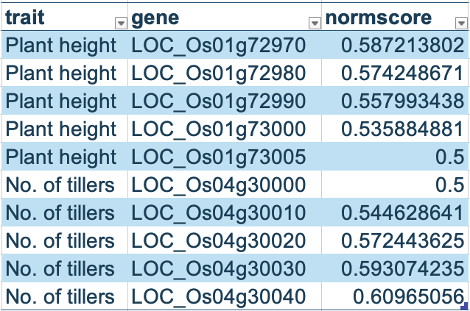
Biological Evidence Data
Trait-Gene Association (QTL) Database
Quantitative Trait Locus - a specific region in DNA responsible for a trait.
Gene-Gene (Co-expression) Database
Notes:
- few examples from the large QTL dataset

Slide 26
Biological Evidence Data
Trait-Gene (QTL)
> 750 RNA-seq experiments for each species
> 2.4 billion distinct gene-gene co-expression relationships
> 160K distinct genes
Gene-Gene
(Co-expression)
Notes:
- over 2.4B distinc coexp relationships
- per-genome only. so rice-maize cannot be co-expressed
- Co-expression occurs when two genes exhibit similar expression patterns
- suggesting they may be functionally related or participate in the same biological process
- when gene1 highly expressed, gene2 also highly expressed. gene1 not expressed, gene2 also not expressed
- not a clear causal relationship. usually a 3rd thing is the cause

Slide 27
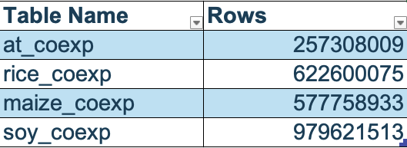
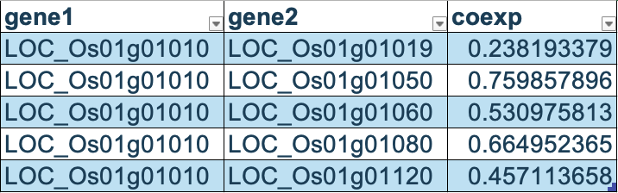
Biological Evidence Data
Trait-Gene (QTL)
Gene-Gene
(Co-expression)
Notes:
- quick look into a few examples of coexp relationships and size of tables

Slide 28
Outline
1. Self-Introduction
5. Trait Similarity Models
2. GeneSieve Overview
6. Gene Ranking Models
3. Biological Evidence Data
7. Website Live Demo
4. Trait-Gene Association Graph
8. Results
Notes:
- now lets dive into the central data model used in GeneSieve (TGAG)

Slide 29
Data Model: Trait-Gene Association Graph
Give a “query” (a trait description in plain English + a set of candidate genes), GeneSieve constructs a TGAG for each candidate, consisting of 4 types of relationships:
  Trait Similarity
  QTL
  Homology
  Co-expression

Slide 30
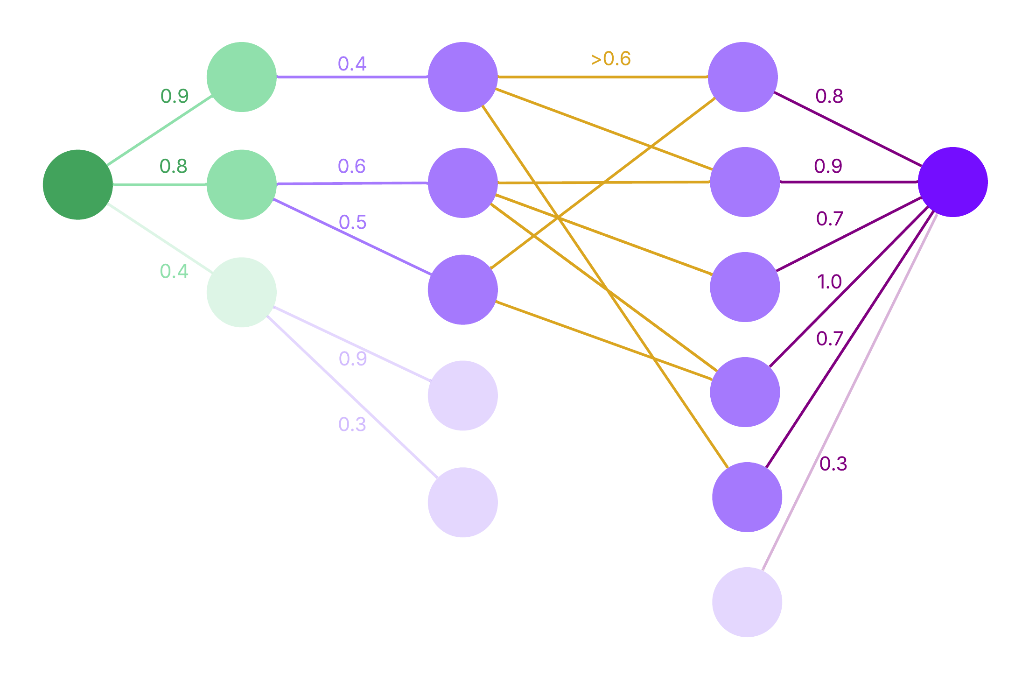
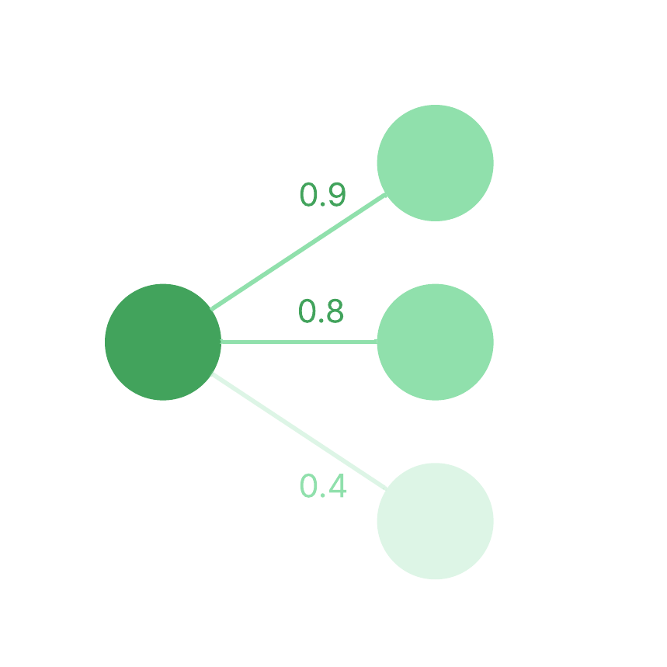
Trait-Gene Association Graph
Trait Similarity
QTL
Homology
Co-expression

Slide 31
Trait-Gene Association Graph
Trait Similarity
Input trait compared against all 1,055 QTL traits
QTL
Pairs with semantic similarity score > 0.6 are selected
Homology
Co-expression
Notes:
- I will get into how this trait similarity is calculated in an upcoming section

Slide 32
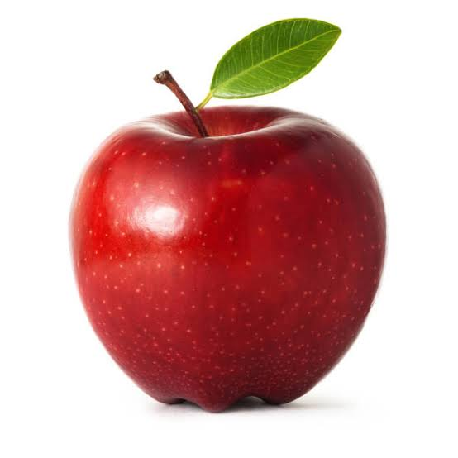
trait you are concerned about right now
traits scientists have looked at before and associated with genes
Redness of apple
anthocyanin accumulation in fruit skin
Firmness of apple
red coloration of apple skin
Notes:
mention anthocyanin causes pigmentation

Slide 33
Trait-Gene Association Graph
Trait Similarity
Input trait compared against all 1,055 QTL traits
QTL
Pairs with semantic similarity score > 0.6 are selected
Homology
Co-expression
Notes:
- I will get into how this trait similarity is calculated in an upcoming section

Slide 34
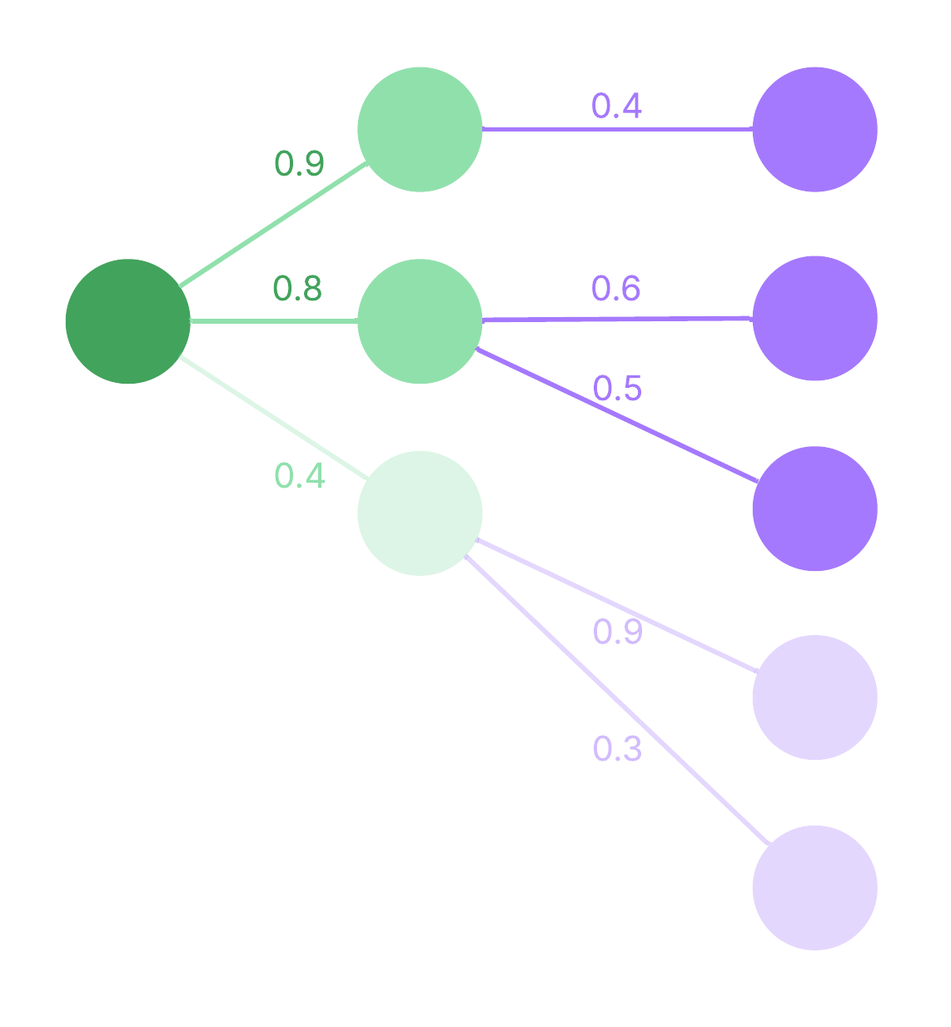
Trait-Gene Association Graph
Trait Similarity
QTL
Homology
Co-expression

Slide 35
Trait-Gene Association Graph
Trait Similarity
QTL genes that are associated with selected QTL traits
QTL
No minimum score filter
Homology
Co-expression
Notes:
- QTL genes associated with selected QTL traits are added to the Graph

Slide 36
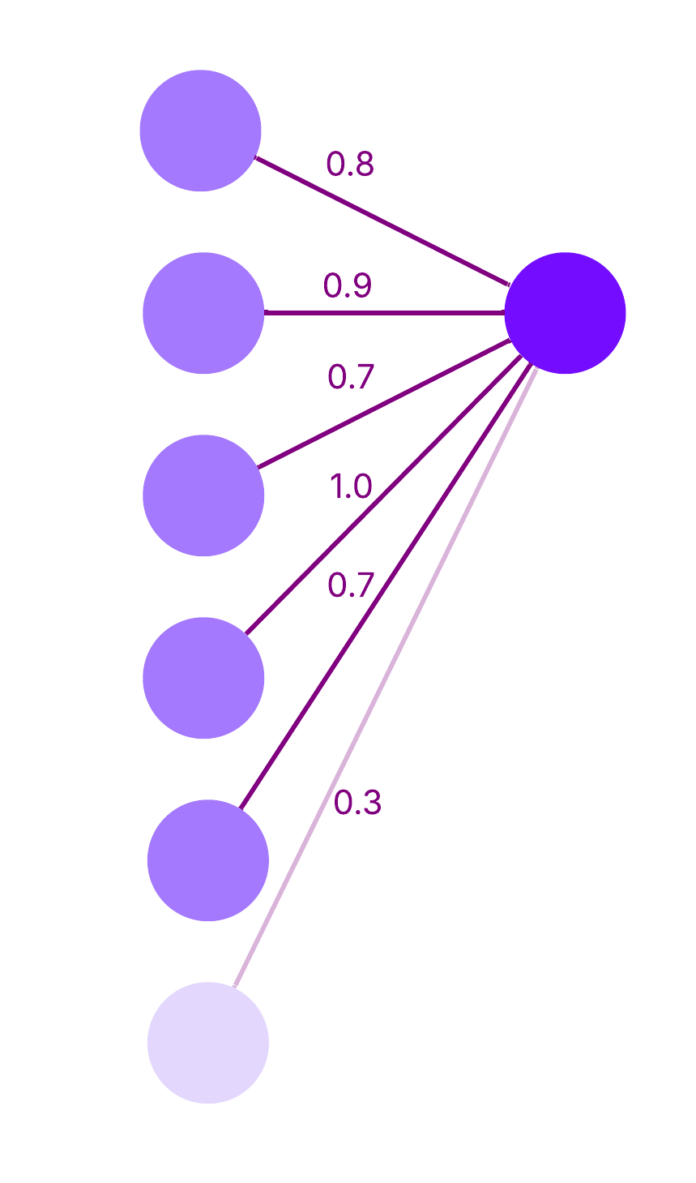
Trait-Gene Association Graph
Trait Similarity
QTL
Homology
Co-expression

Slide 37
Trait-Gene Association Graph
Trait Similarity
Homologous genes are identified using BLAST (Basic Local Alignment Search Tool)
QTL
Homology
BLAST threshold set to 0.6
Co-expression
Notes:
- BLAST = basic local alignment search tool
- computational method

Slide 38
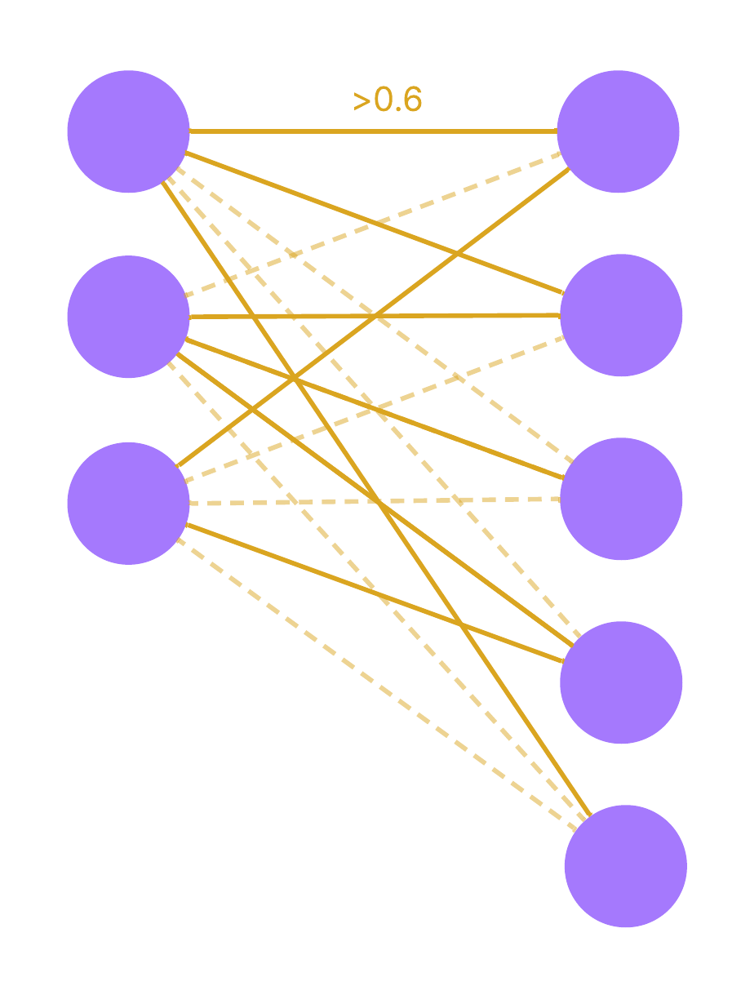
Trait-Gene Association Graph
Trait Similarity
QTL
Homology
Co-expression

Slide 39
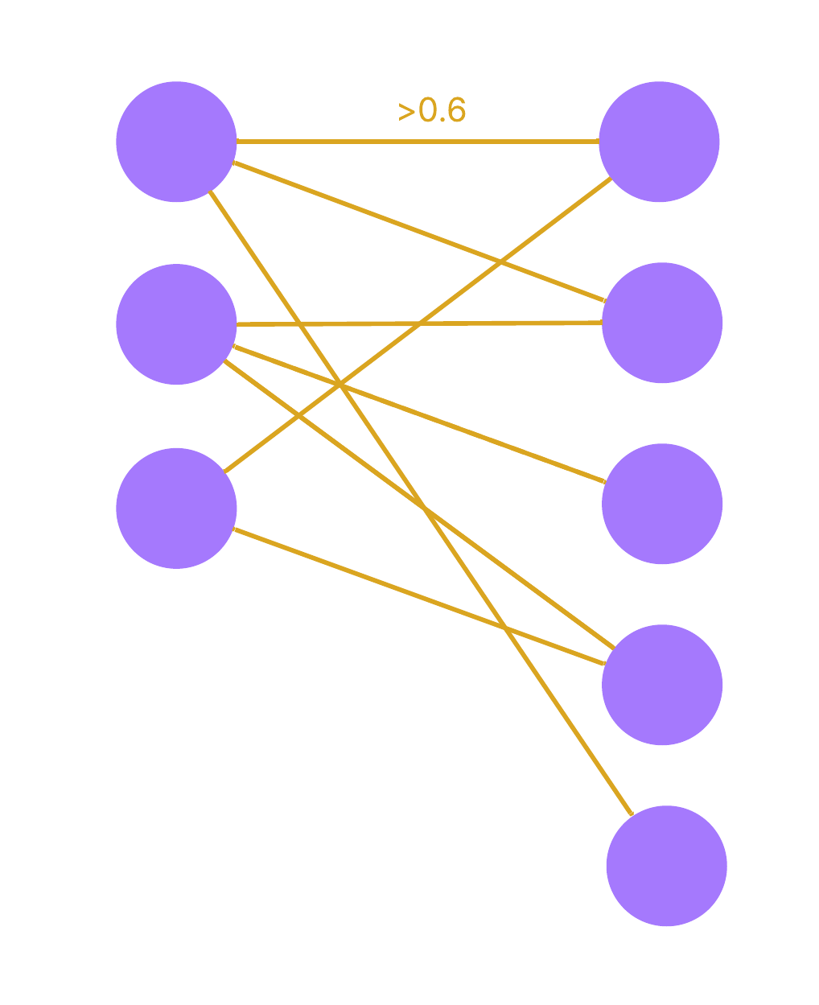
Trait-Gene Association Graph
Trait Similarity
Gene pairs sourced from Co-expression database
QTL
Threshold on co-expression score set to 0.6
Homology
Co-expression
Notes:
- all combinations are checked if exists in coexp dbs

Slide 40
Trait-Gene Association Graph
Trait Similarity
Co-expression edges are sourced from Co-expression Database
QTL
Homology
Co-expression
Notes:
- reminder on how entries look like in coexp dbs
- this is rice

Slide 41
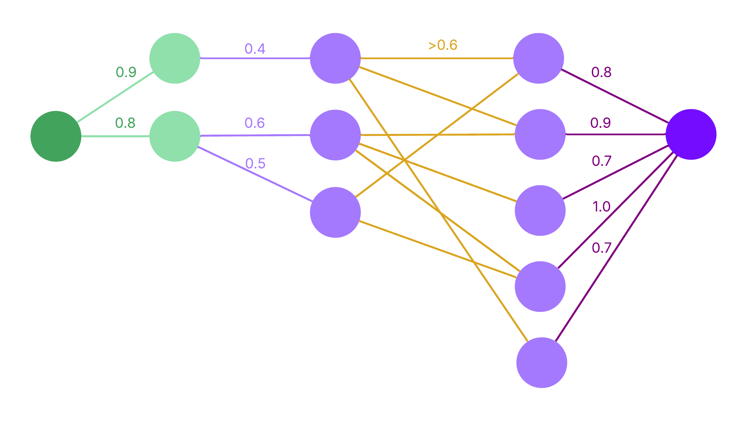
Trait-Gene Association Graph
Trait Similarity
QTL
Homology
Co-expression
Notes:
- simplified topology

Slide 42
Outline
1. Self-Introduction
5. Gene Ranking Models
2. GeneSieve Overview
6. Trait Similarity Models
3. Biological Evidence Data
7. Website Live Demo
4. Trait-Gene Association Graph
8. Results
Notes:
- time to talk about the Gene Ranking Models

Slide 43
Gene Ranking Models
Why use a gene ranking model?
Different candidates produce graphs with different sizes, structures, and evidence patterns
Need a model that converts each heterogeneous graph into one confidence score for ranking candidate genes
The importance of a relationship depends on its context within the graph, not just its edge weight. Need a way capture complex patterns within TGAGs.
Notes:
- consider an example TGAG from the GeneSieve website

Slide 44
Model Training Data
The benchmark TGAGs comprise of 267 examples of synthetic queries that were submitted to GeneSieve.
Each query’s candidate gene set has exactly one known true gene.
The rank of the remaining genes is unknown.
Notes:
- consider an example TGAG from the GeneSieve website

Slide 45
Relational-Graph Convolutional Network (R-GCN)
TGAGs are heterogeneous graphs containing four biologically distinct edge types.
Different relationships contribute differently to identifying causal genes
R-GCN learns relation-specific transformations rather than treating every edge identically
Information propagates through multiple hops, allowing the model to combine complementary biological evidence automatically
Notes:
- consider an example TGAG from the GeneSieve website

Slide 46
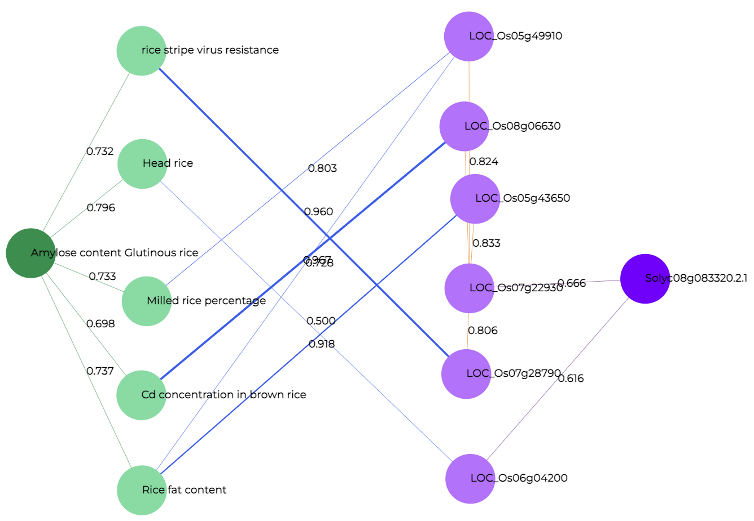
Gene Ranking Model: R-GCN
Let’s explore one R-GCN layer, then see how layers are combined
Notes:
- consider an example TGAG from the GeneSieve website

Slide 47
Gene Ranking Model: R-GCN
Consider this snippet of the larger TGAG
Head Rice
0.796
0.500
Amylose Content Glutinous Rice
LOC_Os06g04200

Slide 48
Gene Ranking Model: R-GCN
We extract their embeddings. distillBERT for traits, ESM-2 for genes
[0.84, 0.25, 0.73, …, 0.88]
(728,)
0.796
0.500
[0.61, 0.63, 0.42, …, 0.26]
[0.57, 0.33, 0.16, …, 0.11]
(728,)
(640,)

Slide 49
Gene Ranking Model: R-GCN
These embeddings were multiplied with a learnable projection matrix, (separate for distillBERT and ESM-2), to reduce the embedding size
[0.34, -0.52, …, 0.49]
(128,)
0.796
0.500
[0.14, -0.31, …, 0.28]
[0.83, 0.72, …, 0.12]
(128,)
(128,)

Slide 50
Gene Ranking Model: R-GCN
These embeddings were multiplied with a learnable projection matrix, (separate for distillBERT and ESM-2), to reduce the embedding size
(
[0.34, -0.52, …, 0.49]
@
)
W_{root}
[0.14, -0.31, …, 0.28]
)
*
(
@
W_{text}
0.796
*
(
0.500
[0.83, 0.72, …, 0.12]
)
@
W_{qtl}

Slide 51
Gene Ranking Model: R-GCN
Messages are calculated
[0.38, 0.43, …, 0.43]
(128,)
[0.56, 0.98, …, 0.83]
[0.20, -0.11, …, 0.03]
(128,)
(128,)

Slide 52
Gene Ranking Model: R-GCN
Messages are calculated
[0.38, 0.43, …, 0.43]
(128,)
mean(
[0.56, 0.98, …, 0.83] ,
[0.20, -0.11, …, 0.03]
)

Slide 53
Gene Ranking Model: R-GCN
This is one round of message passing, for one node. Order-invariant for the entire TGAG
[0.34, -0.52, …,0.49]
(128,)
[0.38, 0.43, …, 0.43]
(128,)

Slide 54
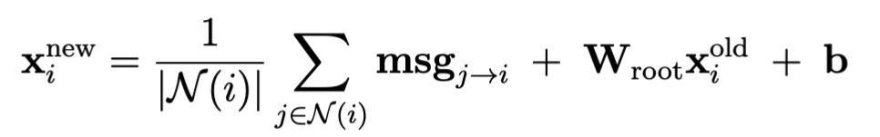
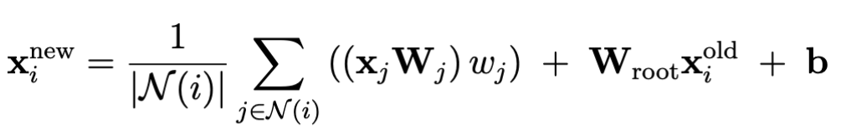
Gene Ranking Model: R-GCN
Message Passing formula that captures all steps detailed:
Message expanded version:

Slide 55
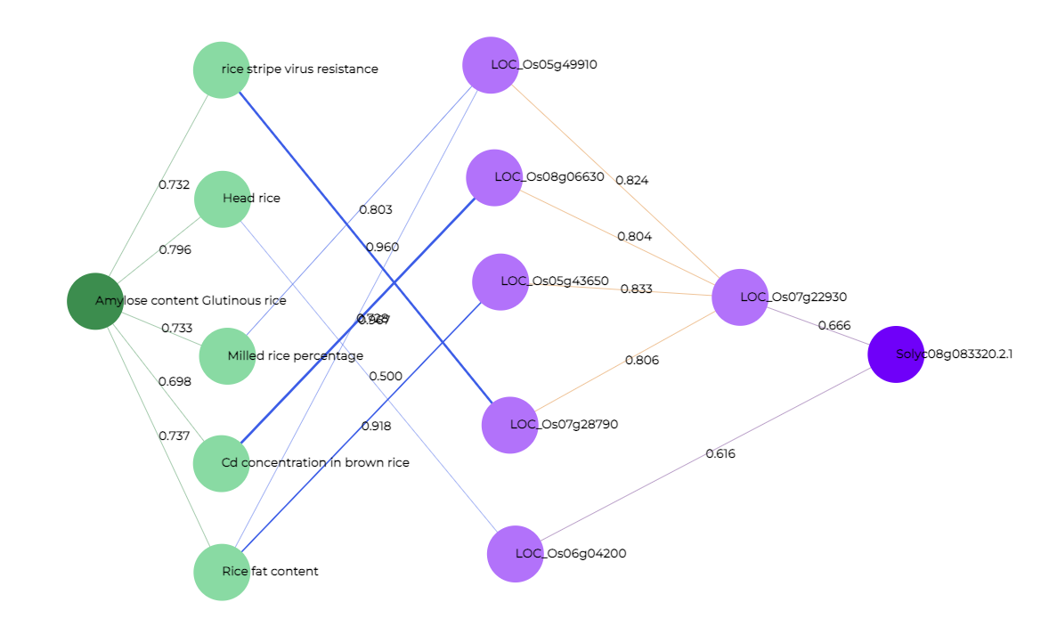
Gene Ranking Model: R-GCN
W_{text}
W_{qtl}
W_{coexp}
W_{root}
W_{homology}

Slide 56
Gene Ranking Model: R-GCN
Multiple layers of R-GCN are formed by simply continuing the message passing process with a new set of weights
W_{root}
W_{root}
W_{text}
W_{text}
W_{qtl}
W_{qtl}
x_{i}¹
@
W_{coexp}
+ bias
x_{i}²
@
W_{coexp}
W_{homology}
W_{homology}
(node embeddings)
Layer 1
Layer 2

Slide 57
Gene Ranking Model: R-GCN
R-GCN Architecture
GeneSieve explores two R-GCN architectures, what we call “R-GCN Pooled” and “R-GCN Deep”
Notes:
- consider an example TGAG from the GeneSieve website

Slide 58
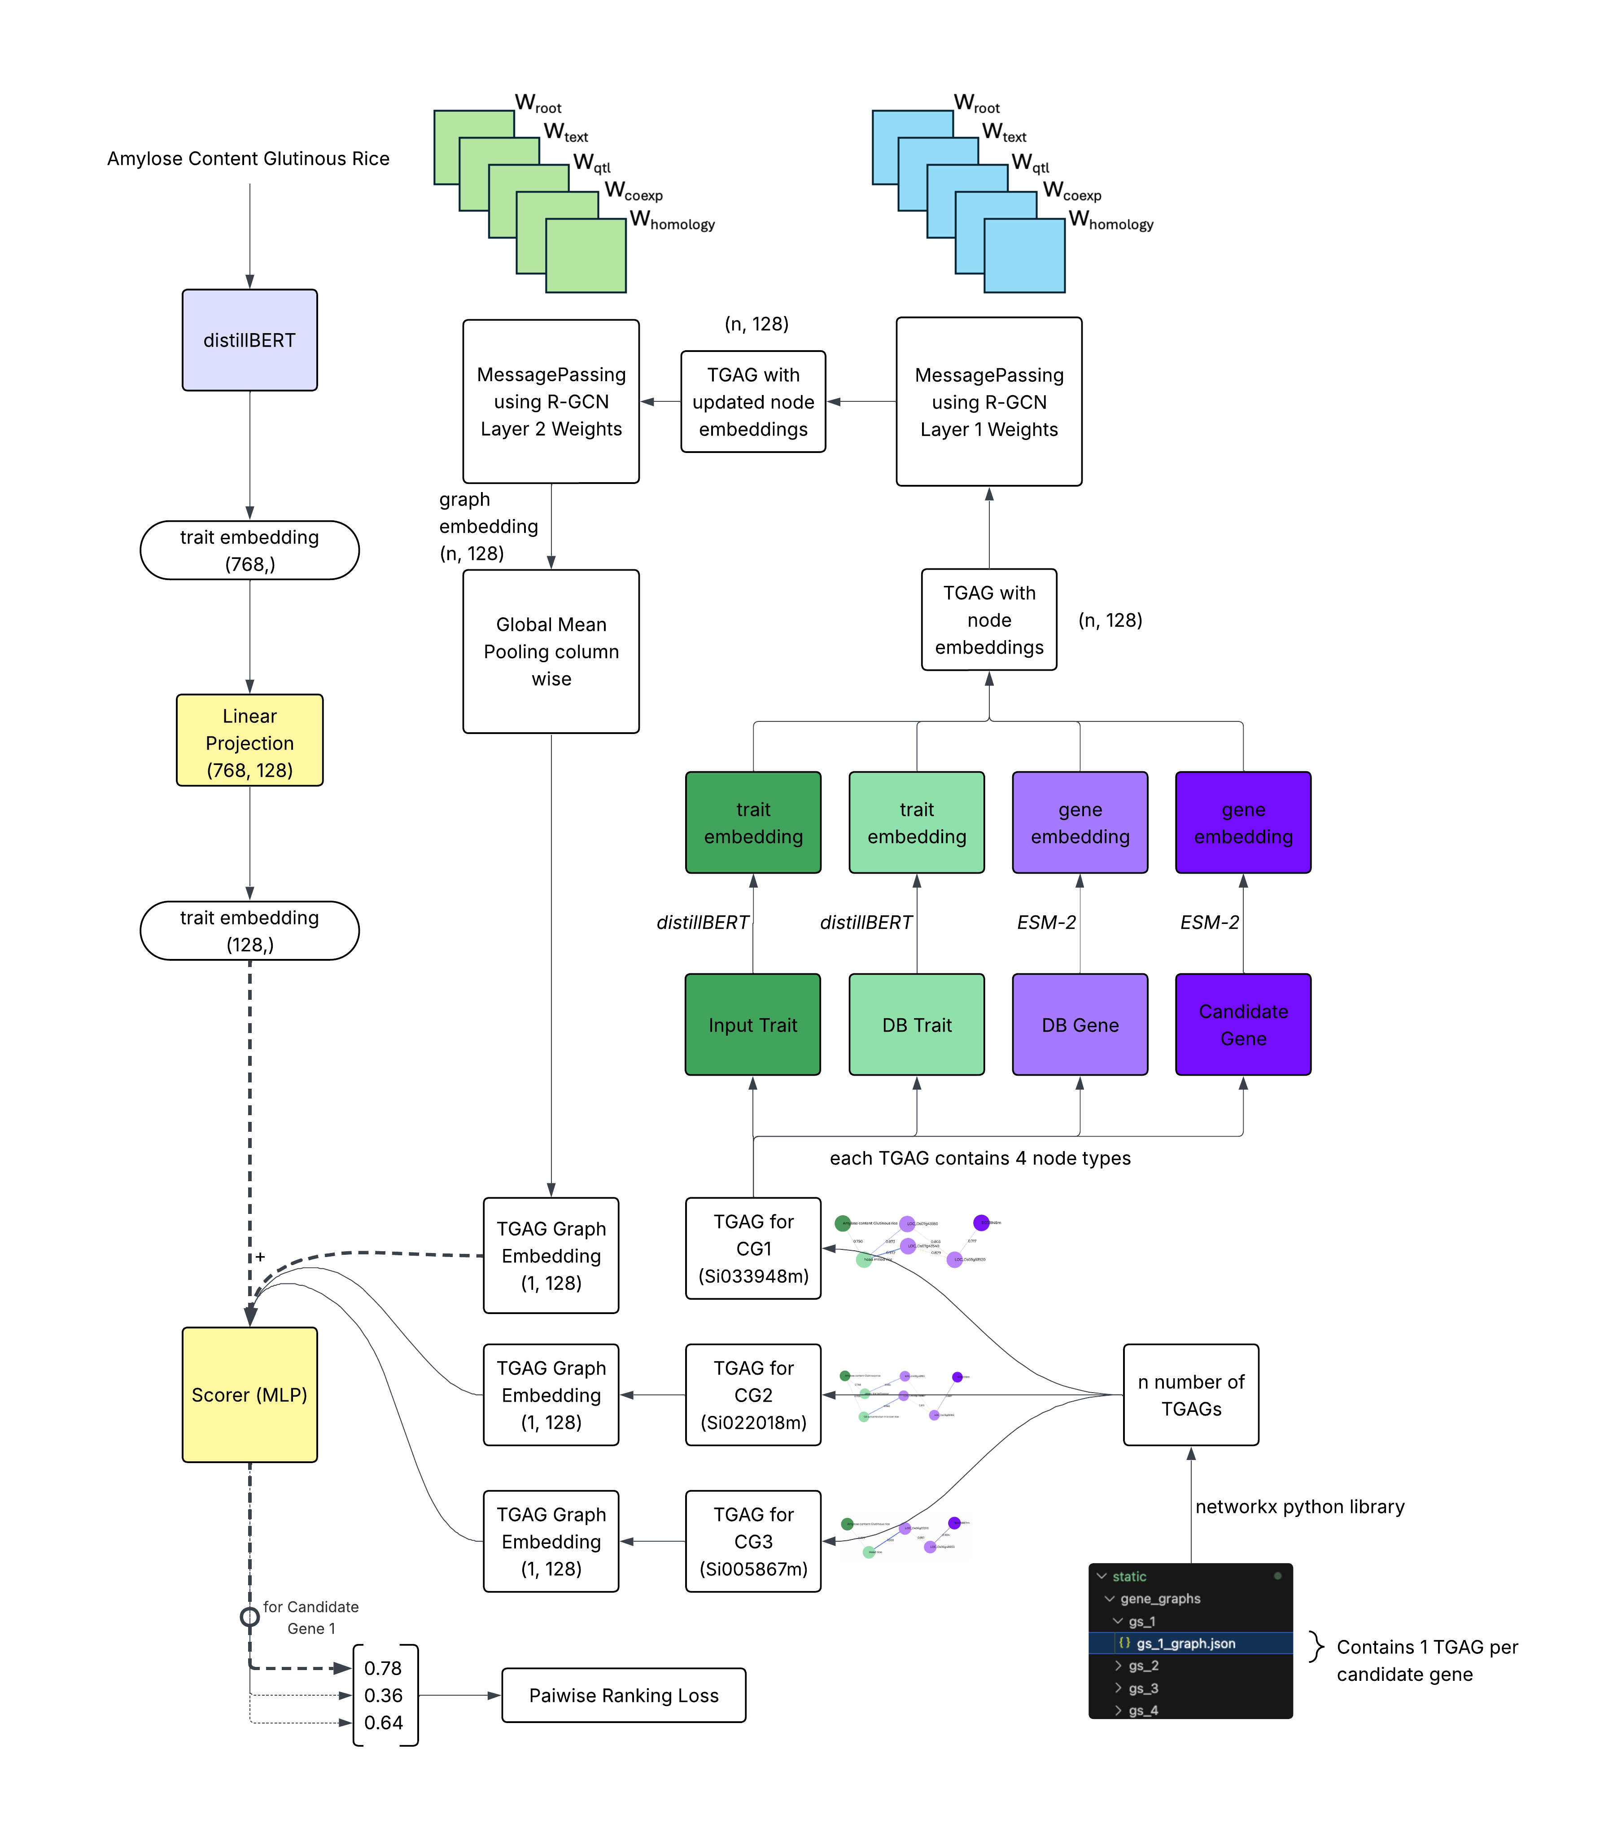
R-GCN Pooled

Slide 59
Each candidate’s TGAG is extracted
A query is submitted to the system

Slide 60
Each node in a TGAG is replaced with its embedding

Slide 61
2 rounds of message passing updates every node’s embedding

Slide 62
R-GCN Pooled
The input trait’s embedding is extracted separately
and projected down to 128-dim through a learnable projection

Slide 63
R-GCN Pooled
Trait embedding is concatenated with graph embedding for each candidate gene
Scorer MLP learns associations between the trait and candidate by processing both their embeddings

Slide 64
R-GCN Pooled
Single floating point score output for each candidate

Slide 65
R-GCN Pooled
MLP Architecture
Linear(256→256) → LayerNorm → ReLU → Dropout(0.2) → Linear(256→128) → ReLU → Linear(128→1)

Slide 66
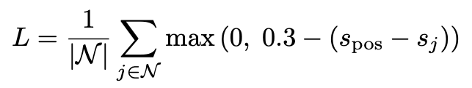
R-GCN Pooled
Pairwise Ranking Loss
Enforces true gene score to be at least “m” higher than all the other gene scores.
Rationale: during training, we only know the true gene. Must enforce highest possible score only for the true causal gene.

Slide 67
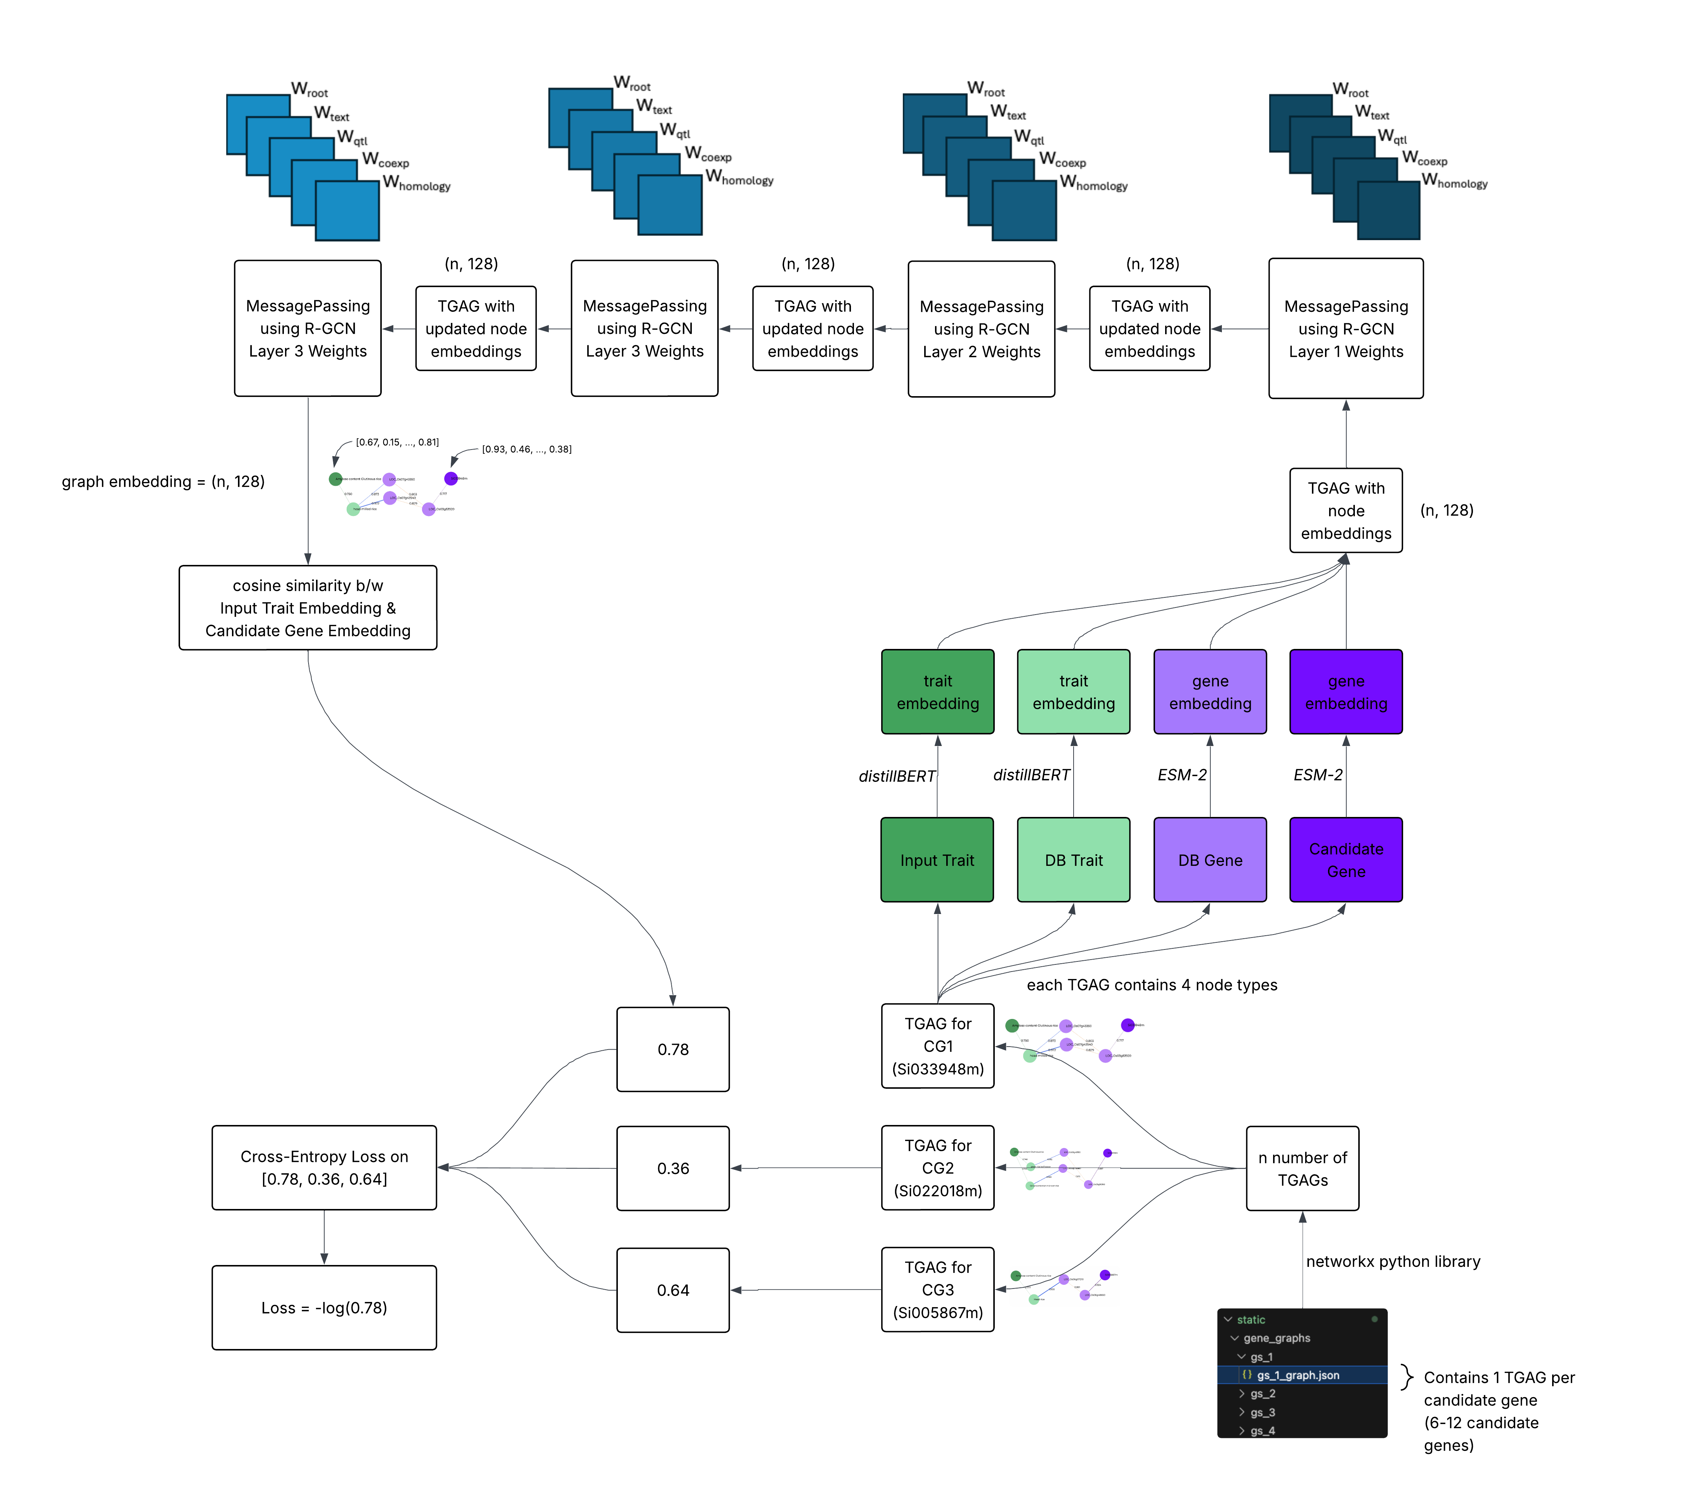
R-GCN Deep

Slide 68
Input query, extract TGAG, replace node names with their embeddings

Slide 69
Four rounds of message passing
Each node has 4-hop knowledge of surrounding biological data

Slide 70
After 4 rounds of message passing
cosine similarity between trait and candidate’s embeddings is taken as candidate’s score

Slide 71
Cross-Entropy Loss for each query (has multiple candidates)
This loss is calculated and used for backprop after every batch (batchsize = 2 queries)

Slide 72
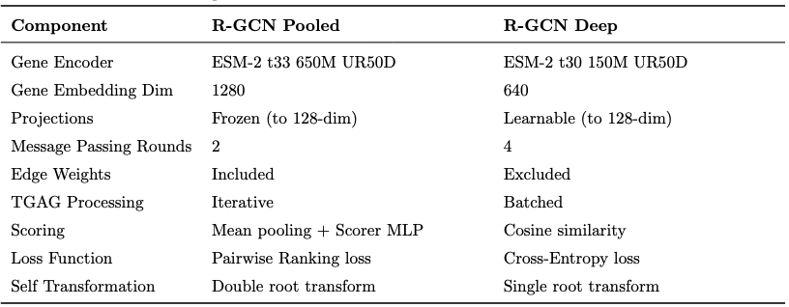
R-GCN Pooled vs. R-GCN Deep
Notes:
- consider an example TGAG from the GeneSieve website

Slide 73
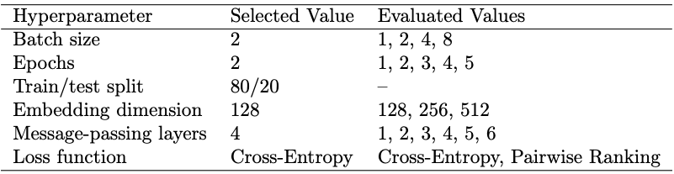
Hyperparameter Tuning
Notes:
- consider an example TGAG from the GeneSieve website

Slide 74
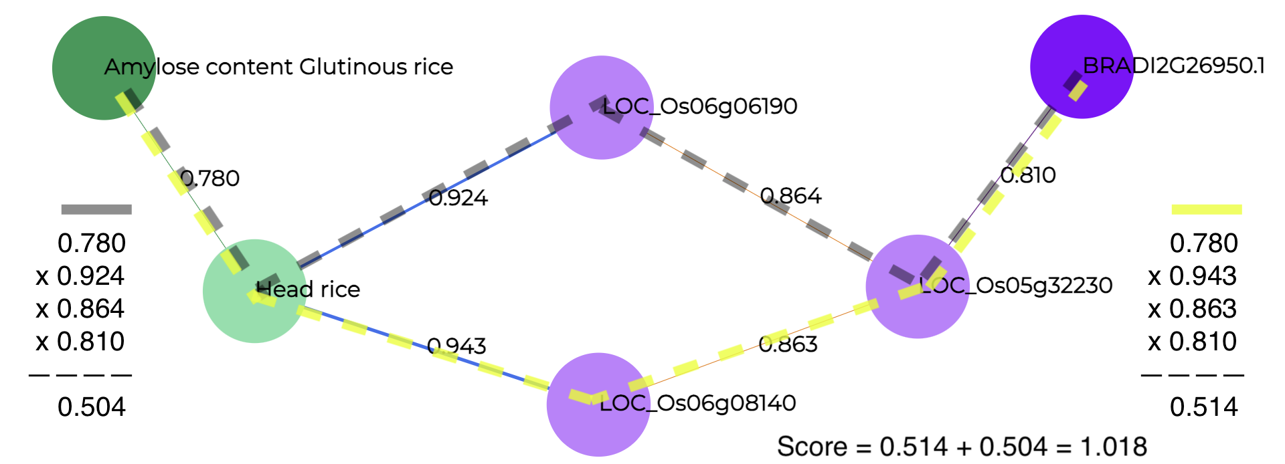
Baseline Model: Sum-of-Products
Scores every path from input trait to candidate gene
Simple, and fails to capture any complex pattern
Algorithm has no basis in biology whatsoever
Notes:
- consider an example TGAG from the GeneSieve website

Slide 75
Baseline Model: Sum-of-Products
Notes:
- consider an example TGAG from the GeneSieve website

Slide 76
Baseline Model: Singular Value Decomposition (SVD)
Converts the heterogeneous graph into a weighted adjacency matrix
Learns low-dimensional embeddings capturing latent biological connectivity.
Ranks genes by similarity between gene and trait embeddings
Treats every relation and every node uniformly (not biologically accurate)
Notes:
- consider an example TGAG from the GeneSieve website

Slide 77
Baseline Model: Random Ranking
Random Ranking
Literally just random
Serves as a sanity check baseline. Any useful model must perform better than a random gene selector
Notes:
- consider an example TGAG from the GeneSieve website

Slide 78
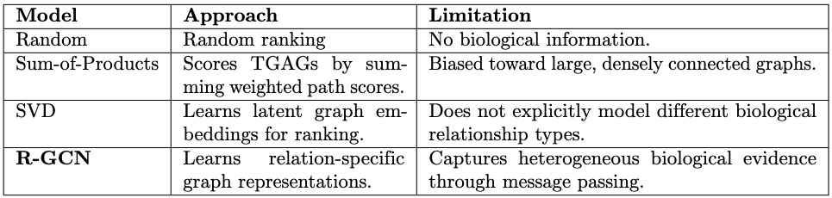
Comparison of Gene Ranking Models
Notes:
- consider an example TGAG from the GeneSieve website

Slide 79
Performance Measures
Measures for Inference & Performance Comparison
Percentile: Measures the candidate gene's percentile rank within its candidate gene set after ranking all candidates. Sensitive to candidate set size, making comparisons across folders less reliable.
Raw Rank: Records the candidate gene's absolute rank after ranking all candidates. Assumes missing genes have already been filtered out, so it does not isolate the ranking model's performance alone.

Slide 80
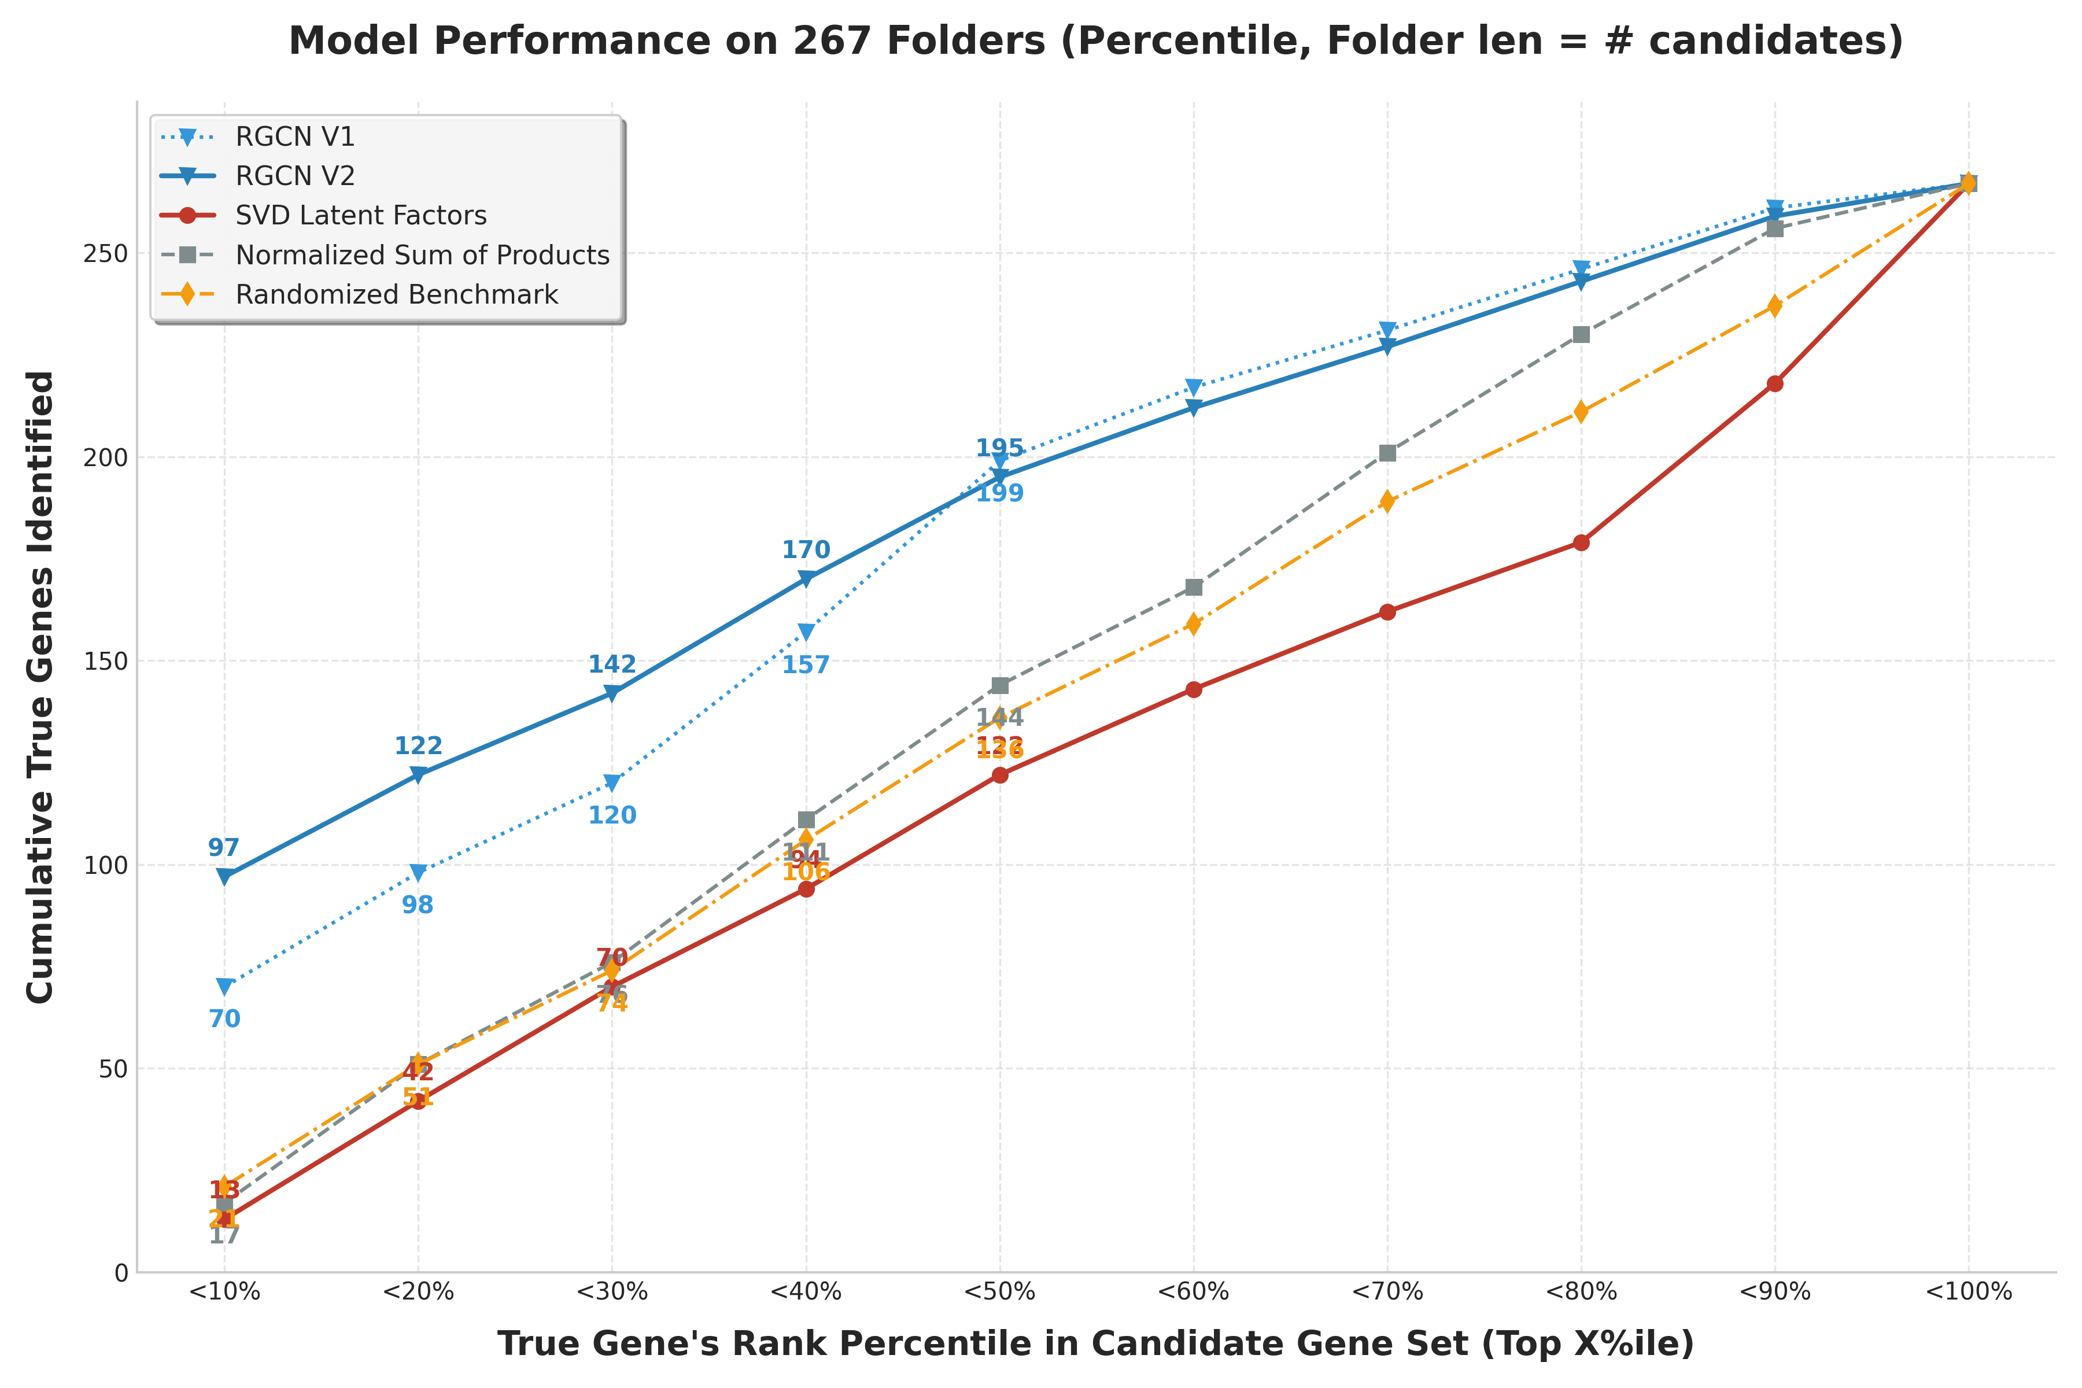
Experiment Results

Slide 81
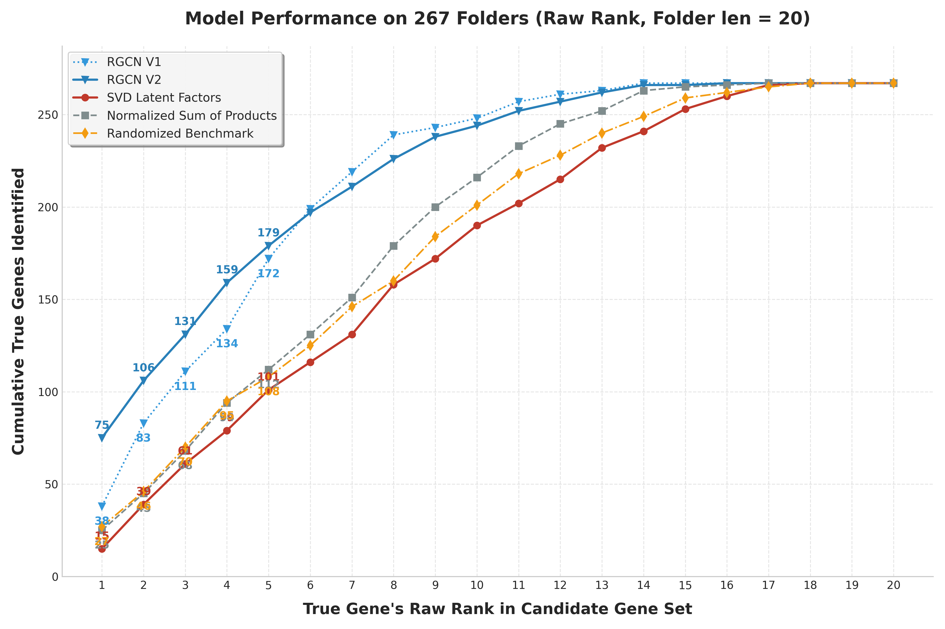
Experiment Results

Slide 82
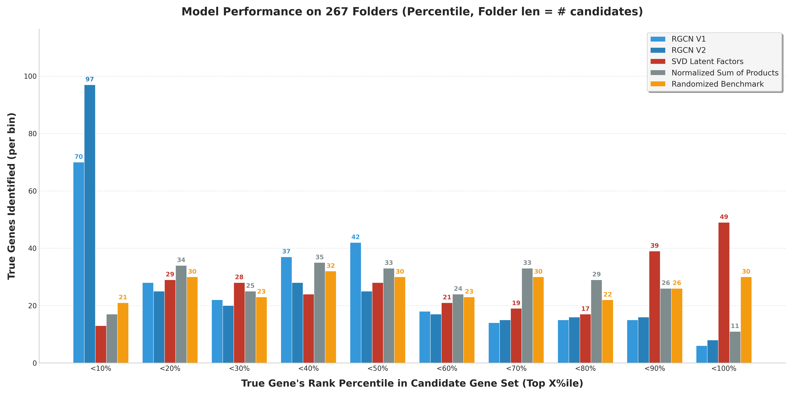
Experiment Results

Slide 83
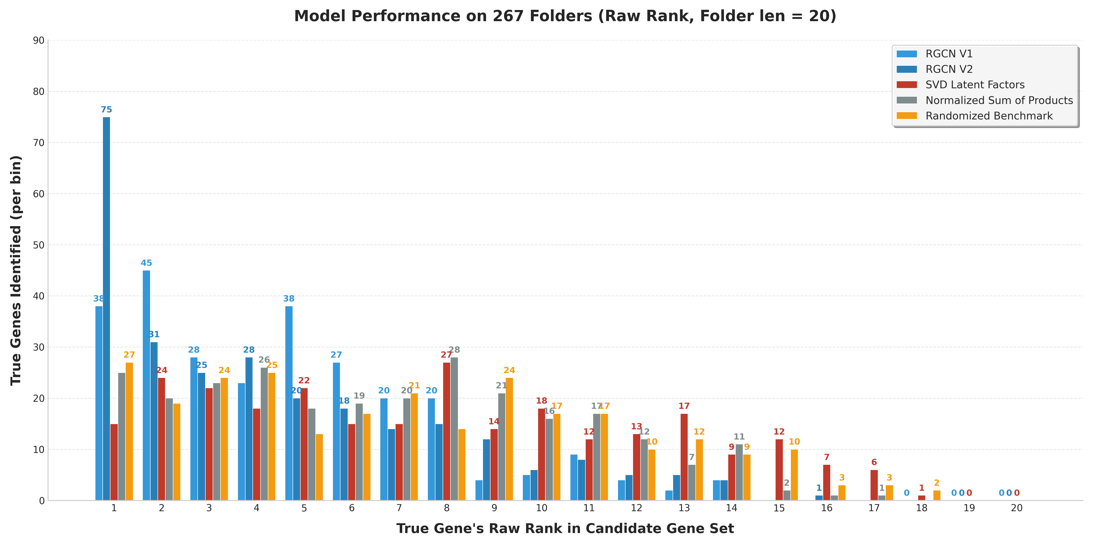
Experiment Results

Slide 84
Outline
1. Self-Introduction
5. Gene Ranking Models
2. GeneSieve Overview
6. Trait Similarity Models
3. Biological Evidence Data
7. Website Live Demo
4. Trait-Gene Association Graph
8. Conclusions

Slide 85
Trait Similarity Models
Doc2Vec
Fine-tuned LLM

Slide 86
Doc2Vec
Initial Model, now treated as a baseline
Trained on 417 plant articles from Wikipedia
API fetch article data live
Train doc2vec weights to embed vectors
Trained model applies cosine similarity
Notes:
- Extension of Word2Vec for learning document embeddings.
- Maps a sequence of tokens to a fixed-length embedding vector.
- Trains a shallow neural network to learn document vectors by predicting surrounding words.

Slide 87
Trait Similarity Models
Doc2Vec
Fine-tuned LLM
Notes:
- Why use finetuned LLM?
- how is it better than just prompting gpt directly

Slide 88
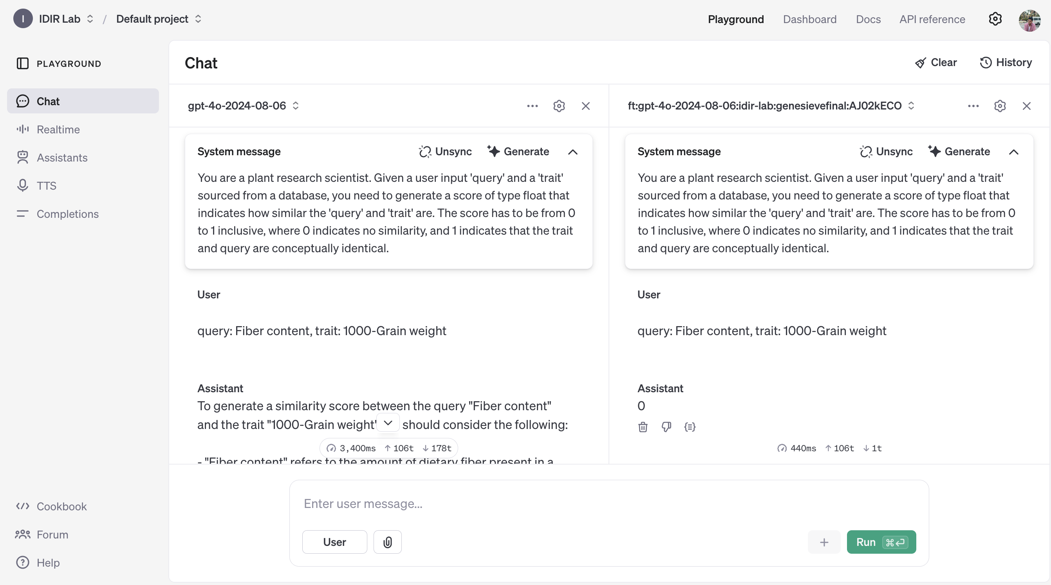
Fine-tuned LLM
Notes:
- concise, to the point response
- understands scoring policy much better through annotated examples
- we need annotated data though

Slide 89
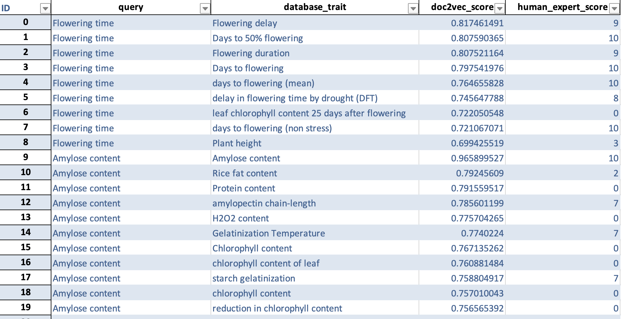
Fine-tuned LLM
Human Expert (Dr. Justin) Annotated Dataset
Notes:
- this is the annotated dataset
- 293 rows

Slide 90
Fine-tuned LLM
Fine-tuned OpenAI GPT-4o model
Stratified 5-Fold CV on Human Expert Annotated Dataset
64-16-20 Train-Validation-Test Split
Fine-tuned model compared against Doc2Vec baseline
Notes:
- explaining the finetuning methodology
- we are scoring trait pairs for semantic similarity
- mode is NOT trained on validation set
- test set is used as a second check (sanity check) for closeness to human annotation for trait pairs

Slide 91
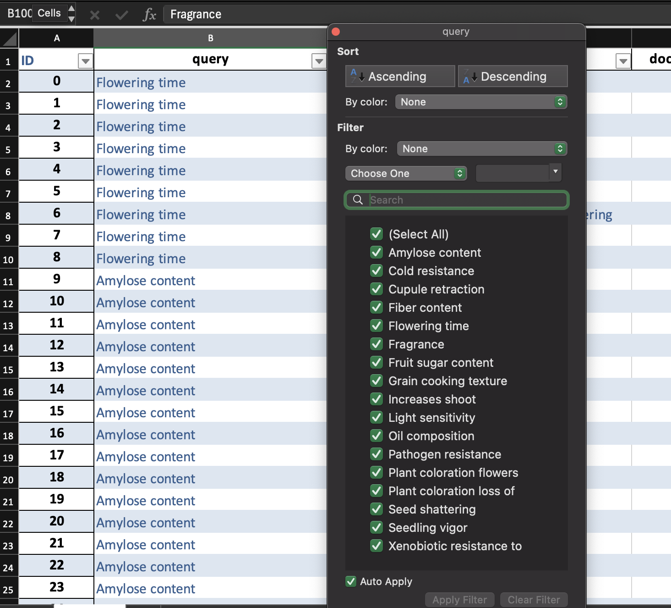
Fine-tuned LLM
Why Stratify?
# of data points for each query differs widely
Amylose Content – 15
Xenobiotic Resistant – 5
Total rows – 293
Notes:
- distribution of traits in pairs not equal

Slide 92
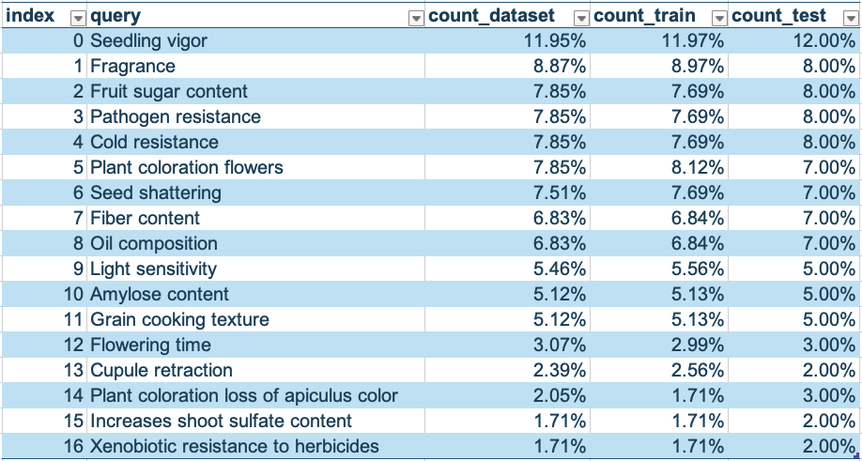
Fine-tuned LLM
Fold 1/5, train-test split

Slide 93
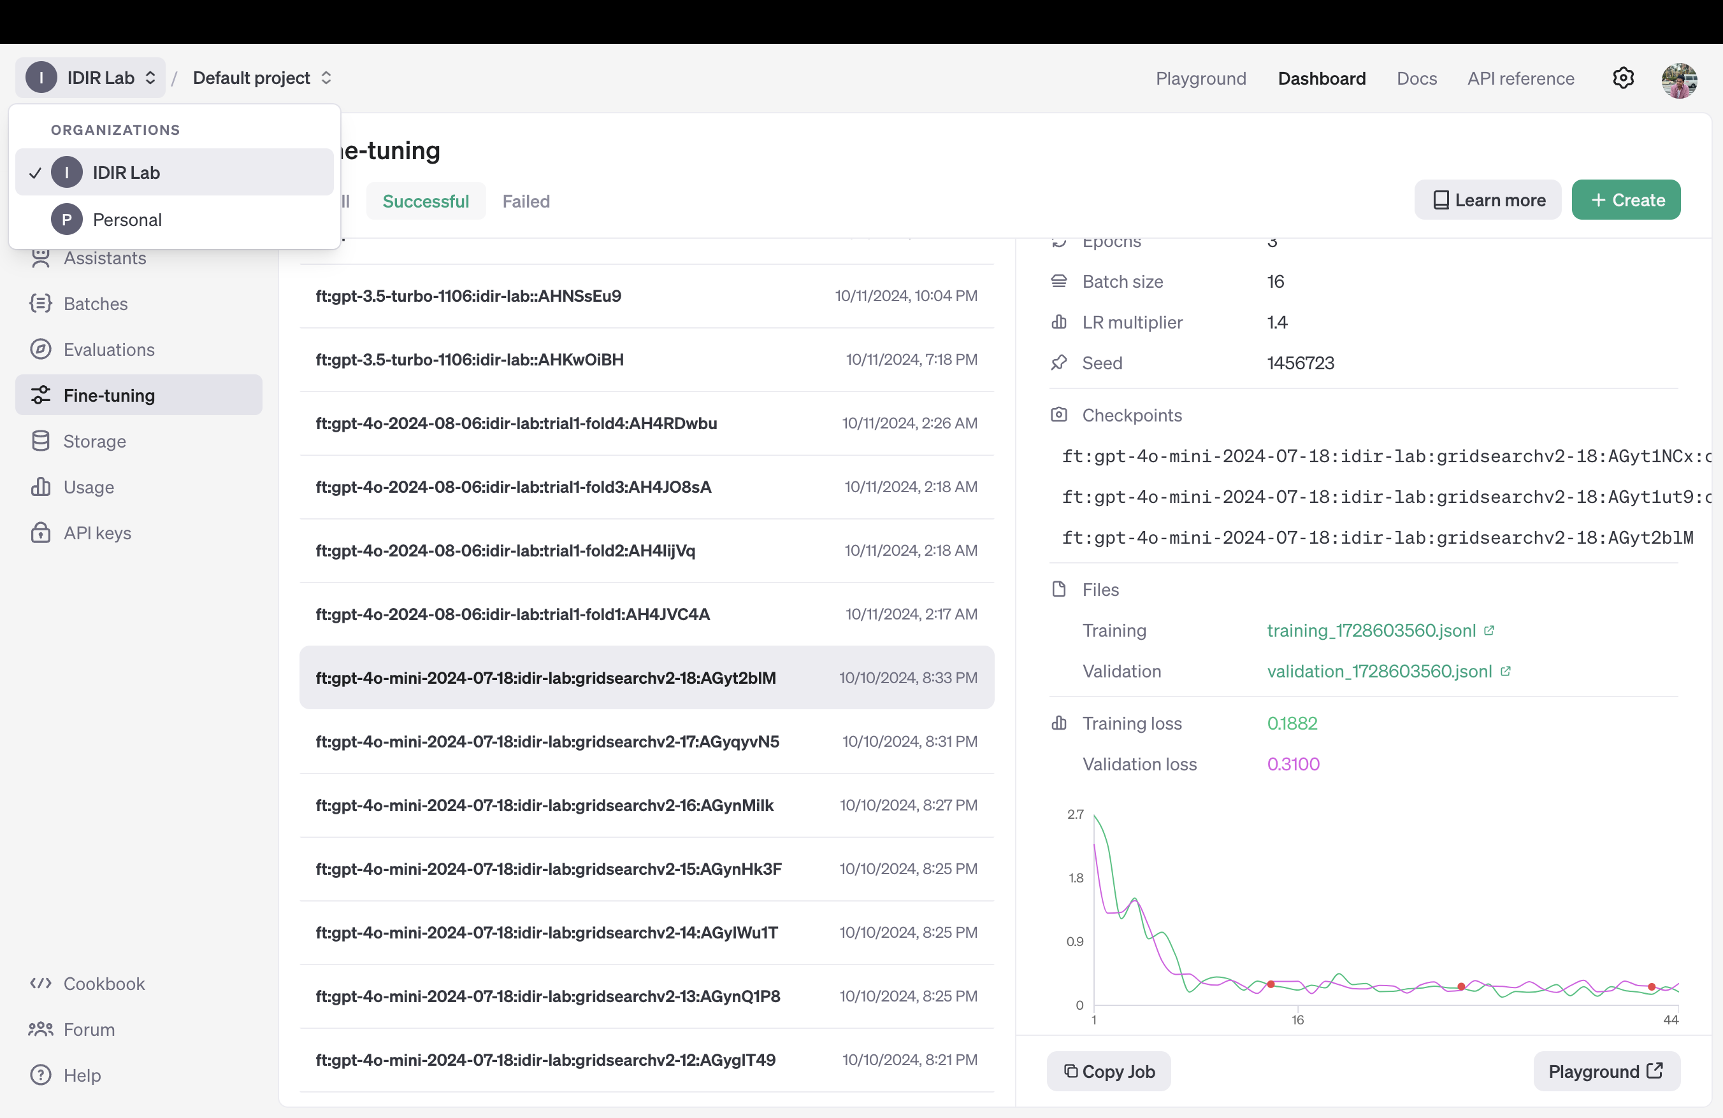
Fine-tuned LLM
Notes:
- view training and validation loss
- hyperparam tuning
- check training and validation stability

Slide 94
Fine-tuned LLM
Doc2vec scores are very skewed
Need to make all data comparable
Human Expert Annotation
Fine-tuned GPT-4o
Doc2Vec

Slide 95
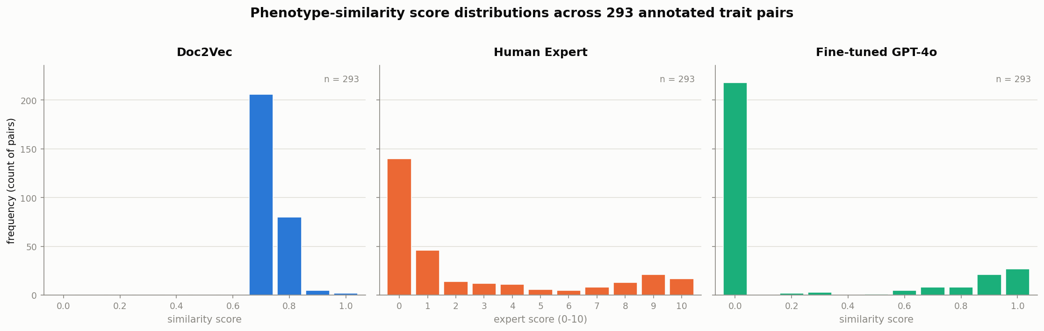
Fine-tuned LLM
Notes:
- shared y axis

Slide 96

Fine-tuned LLM
Solution
Make all 3 datasets fall into the same distribution
We have two measures for this – Percentile and Normalize
Evaluation
Minimize distance from Human Expert Annotation (Error)
Notes:
- need apples to apples comparison
- need all distributions to be spread from 0 to 1 (doc2vec is spread from 0.6 to 0.8)
- error formula

Slide 97
Fine-tuned LLM
Measure 1: Percentile
For all datasets, convert scores to their respective percentiles
Add small random perturbation to the initial scores → break ties in percentiles
Measure 2: Normalize
Doc2Vec scores are stretched to a scale of 0-1.
All other scores are considered as is.

Slide 98
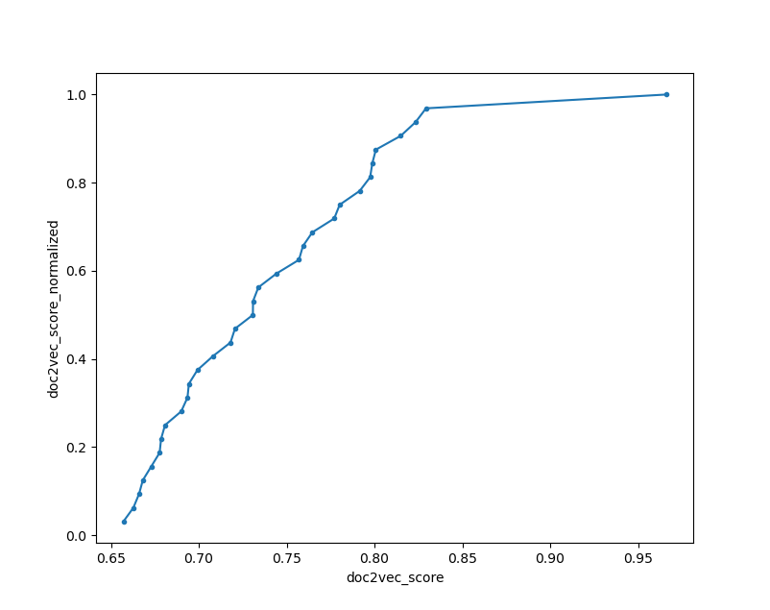
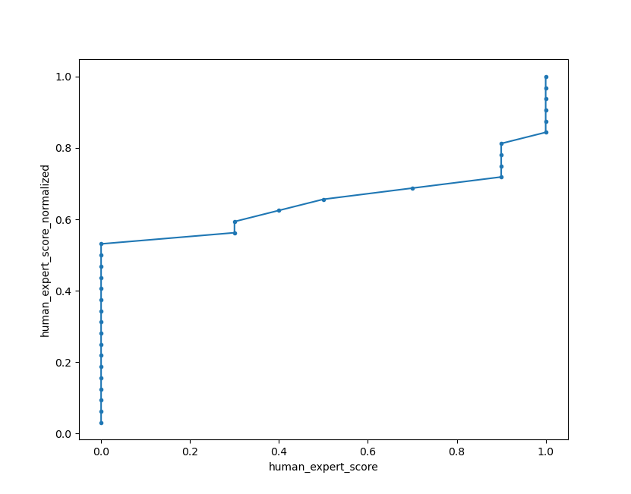
Fine-tuned LLM
Notes:
- 32 data points from test split in all the plots (140+32 train test split)
- this was from an older run before justin annotated more data

Slide 99
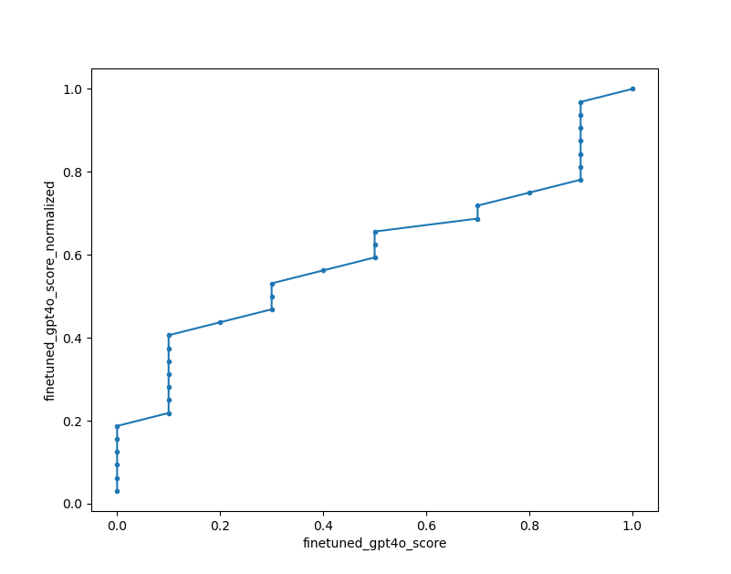
Fine-tuned LLM
Notes:
- dovetails y=x a little more

Slide 100
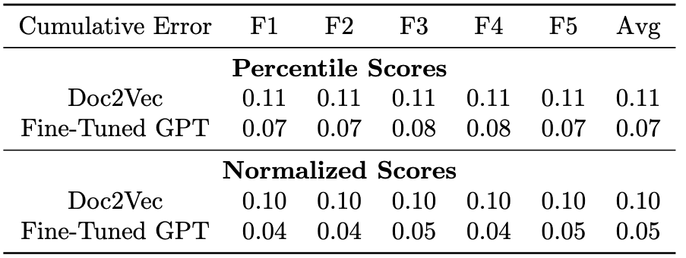
Fine-tuned LLM – Evaluation
Notes:
- measuring cumulative error from fold-wise validation splits
- gpt4o finetuning brought error down by a lot. meaning its closer to human expert annotation

Slide 101
Fine-tuned LLM
 | Percentile | Stretch
Mean cum. doc2vec Error | 1.14 | 1.0
Mean cum. Fine-tuned GPT-4o Error | 0.78 | 0.46
Drop in Error for finetuned model | 31.78% | 54.22%

Slide 102
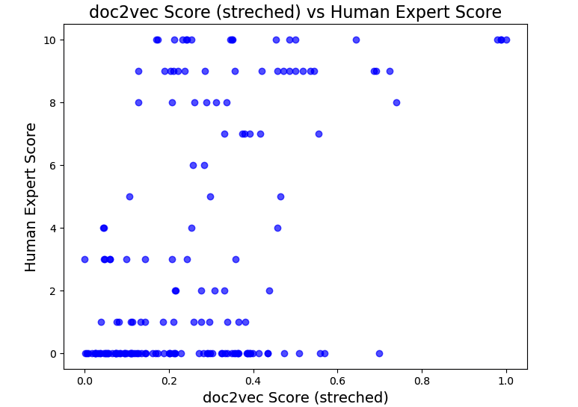
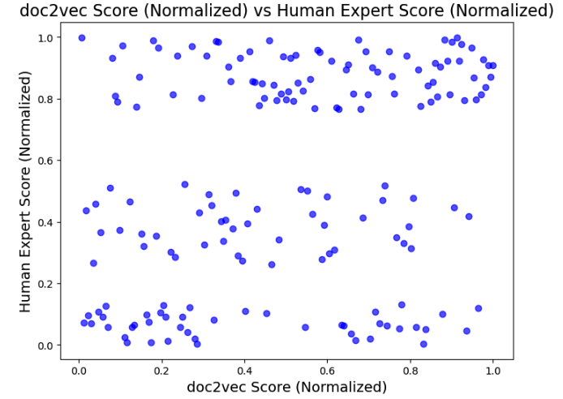
Fine-tuned LLM
Notes:
- almost zero correlation with human expert annotated scores. bad signal

Slide 103
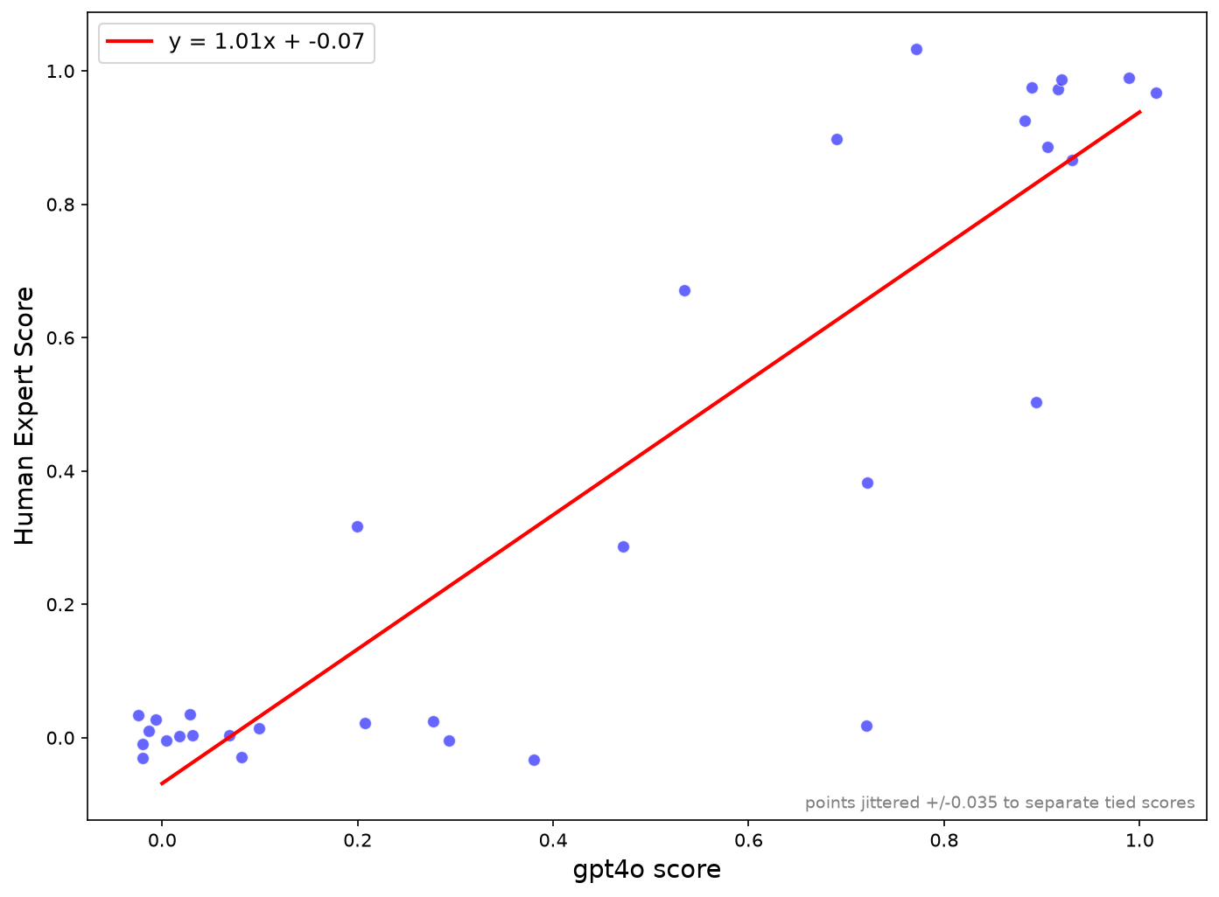
Fine-tuned LLM
Notes:
- almost perfect y=x correlation

Slide 104
Trait Similarity Models
Doc2Vec
Fine-tuned LLM

Slide 105
Trait Similarity Models
Fine-tuned LLMs can:
Learn the annotators' scoring behavior
Display superior semantic understanding than Doc2Vec

Slide 106
Outline
1. Self-Introduction
5. Gene Ranking Models
2. GeneSieve Overview
6. Trait Similarity Models
3. Biological Evidence Data
7. Website Live Demo
4. Trait-Gene Association Graph
8. Conclusions

Slide 107
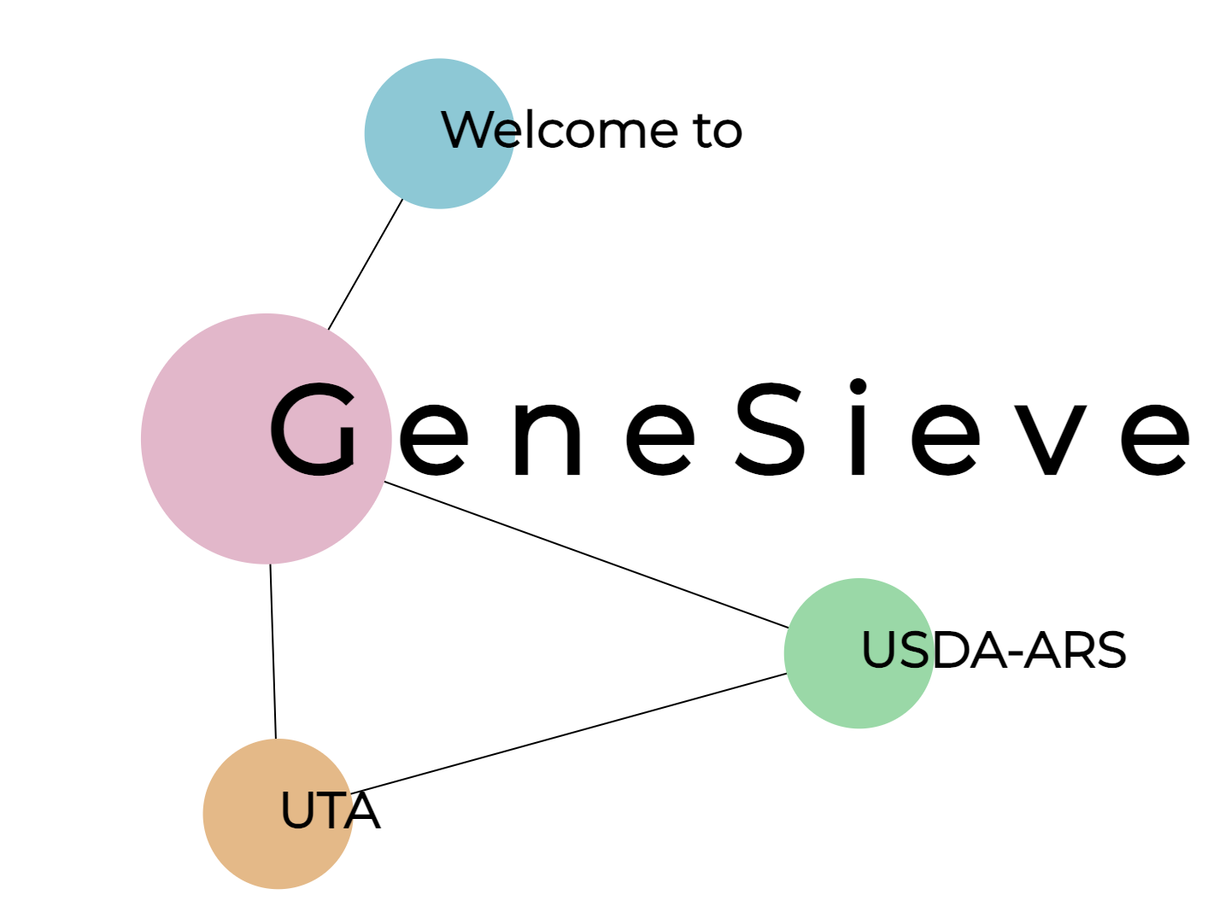
Website Live Demo
http://idir.uta.edu/genesieve
Notes:
- good example for task id run check 20260726_191417 Pathogen Resistance

Slide 108
Outline
1. Self-Introduction
5. Gene Ranking Models
2. GeneSieve Overview
6. Trait Similarity Models
3. Biological Evidence Data
7. Website Live Demo
4. Trait-Gene Association Graph
8. Conclusions

Slide 109
Conclusion
The novelty of GeneSieve lies in addressing key limitations of existing candidate gene prioritization methods by constructing query-specific heterogeneous graphs that integrate LLM-derived trait similarity, curated trait–gene associations, RNA-seq-derived gene co-expression, and sequence homology into a unified graph framework.
This enables evidence-driven R-GCN-based prioritization across diverse monocot and dicot plant species, rather than relying on static knowledge graphs, isolated evidence sources, or direct LLM prediction.
Notes:
- good example for task id run check 20260726_191417 Pathogen Resistance

Slide 110
Thank you!
Notes:
I want to conclude by thanking all of you for listening and thanking those who supported this journey. This research spanned several years and wouldn’t have been possible without my advisor, committee, colleagues, and the annotators and participants who contributed. I truly appreciate your time and attention today.

